Slide 1
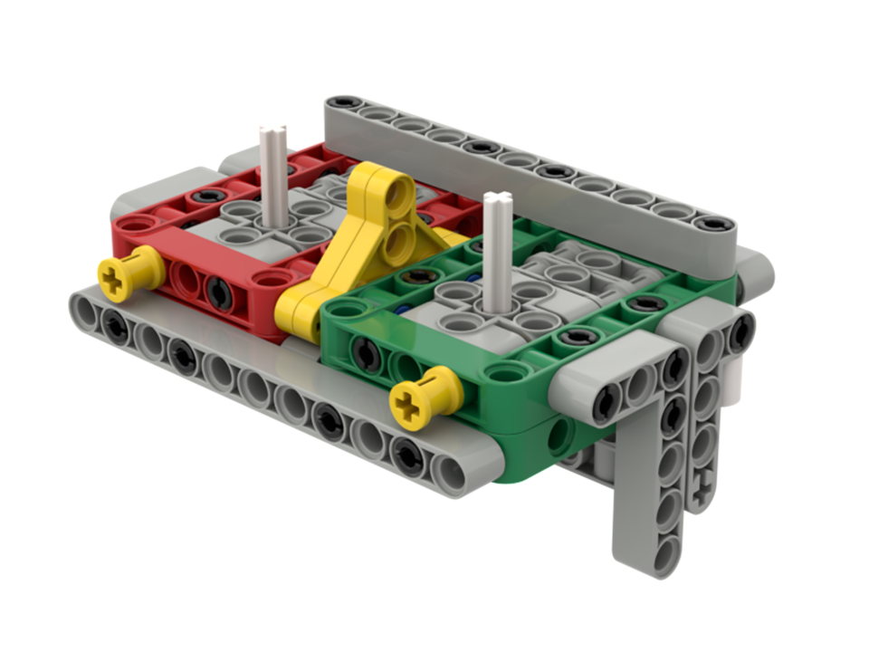
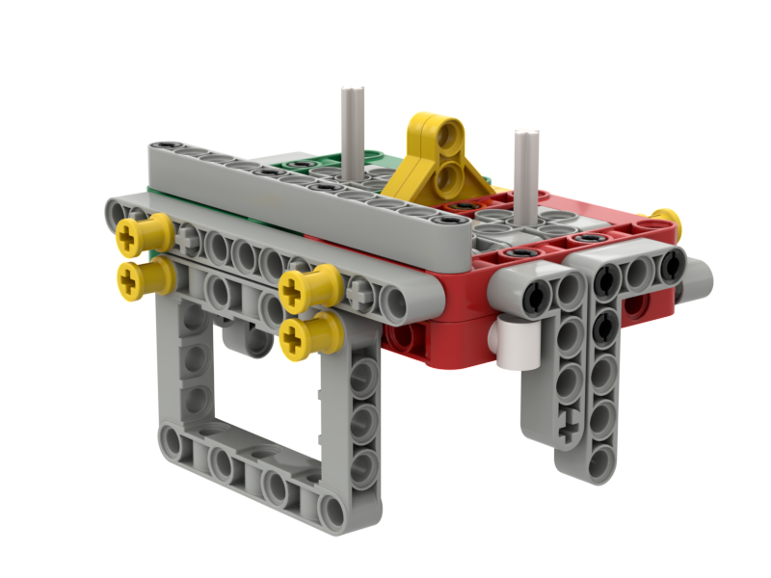
Base Attachments

Slide 2
Base Attachment Step One
We build all of our attachments so they are universal and can simply drop in place. But these instructions will only get you so far. You have some decisions to make.
For example, which way do you need your axles to point? You could have both axles sticking out the front. Or you could have both sticking out the sides. Or you could have one of each. Or you could have only one axle. You can switch the red and green. It's all up to you.
Also, you have to decide what gear ratio you want to use. Do you need more torque or more speed? We have options!
Before you go any further, think about where you want your axles and how strong your attachment needs to be when you are done. Talk to a coach if you aren't sure.
Forward

Slide 3
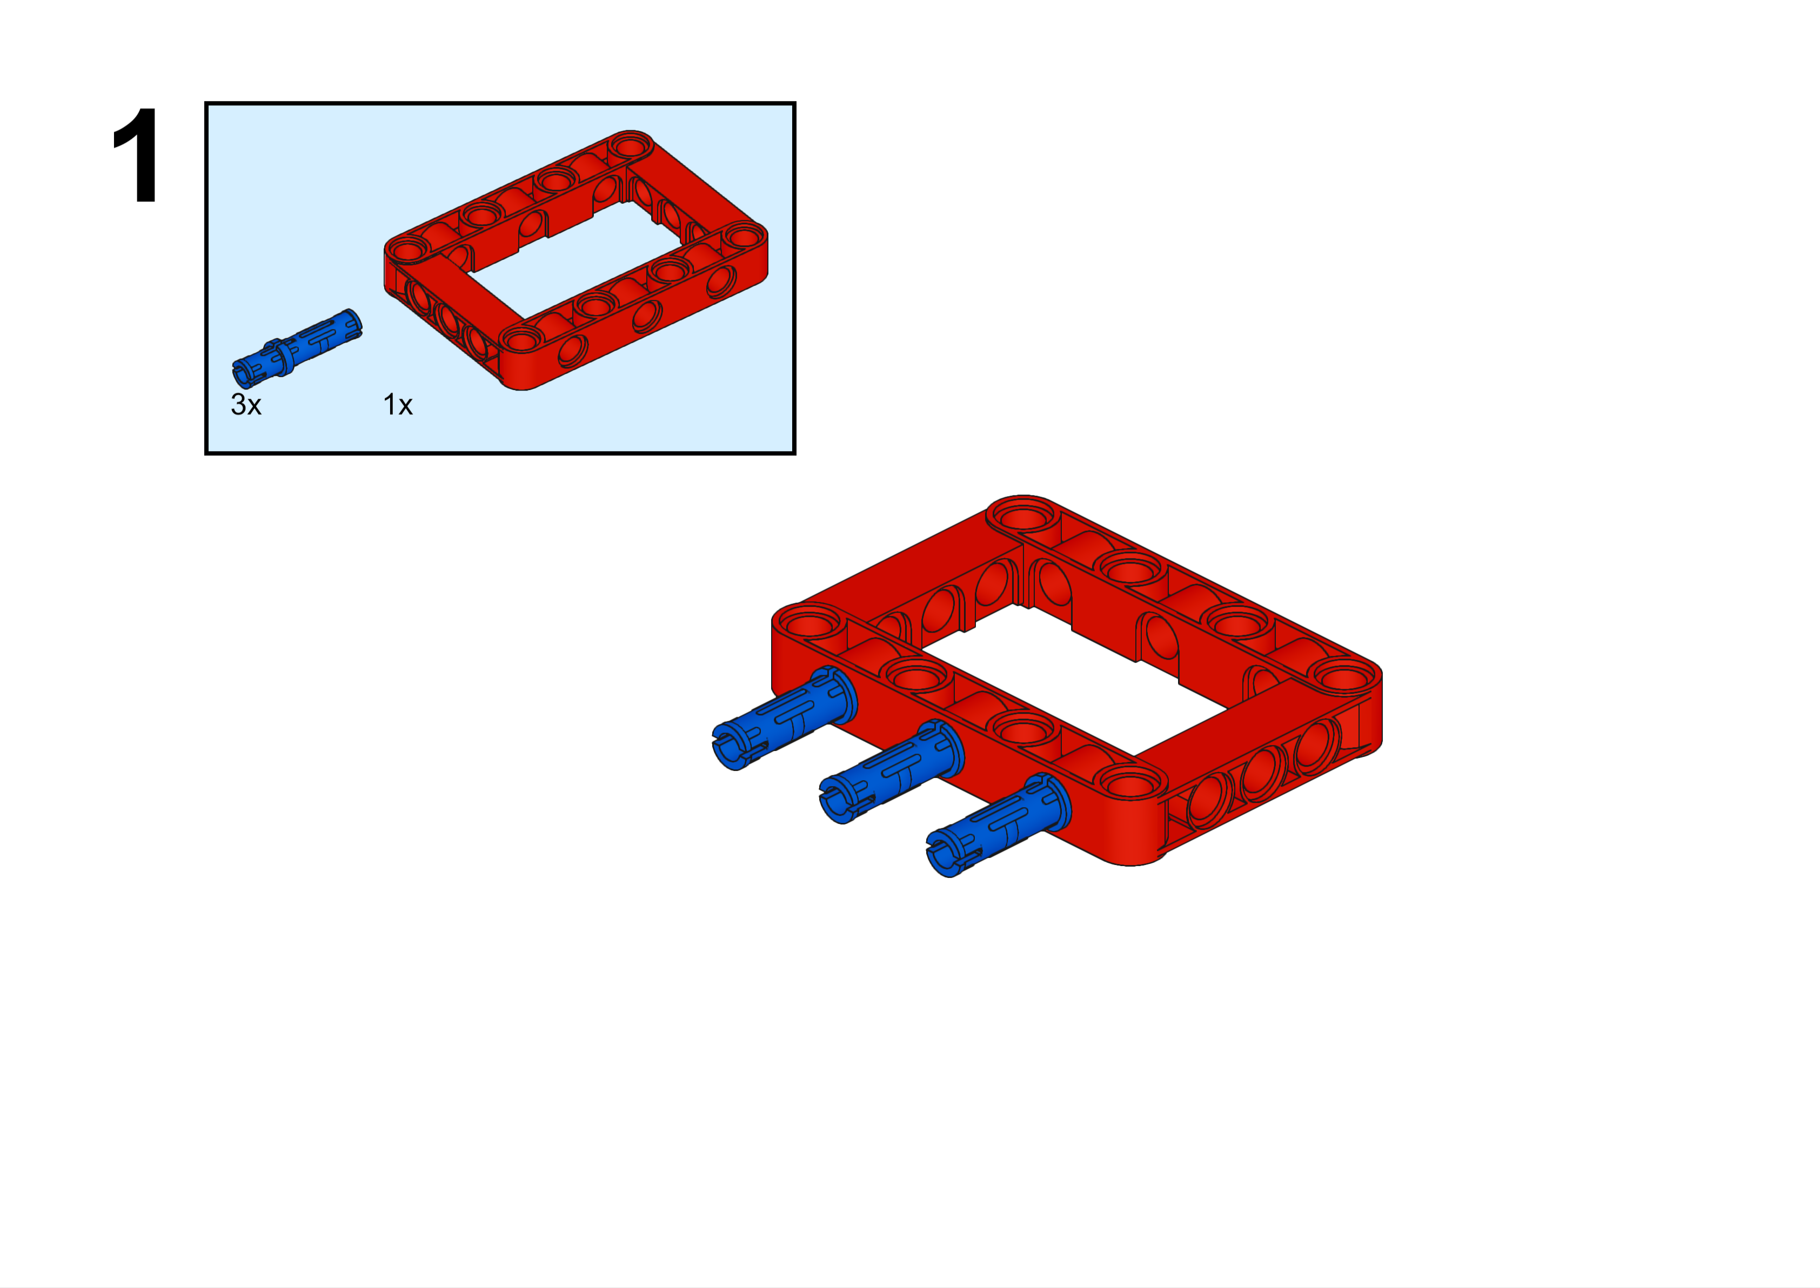
These are the "Build Plate" build instructions. All of your attachments will start with this. It is then up to you to figure out what else you need on your attachment. Everything will attach to this. You will not be able to "pin attach" anything directly to the robot, with one rare exception.
The large piece is called a "frame". It is five by seven studs. The blue peg is three studs long. You will be using these pieces a lot with your robot. You should have these pieces in your colored bin of parts, but we have more in storage if you need them.

Slide 4
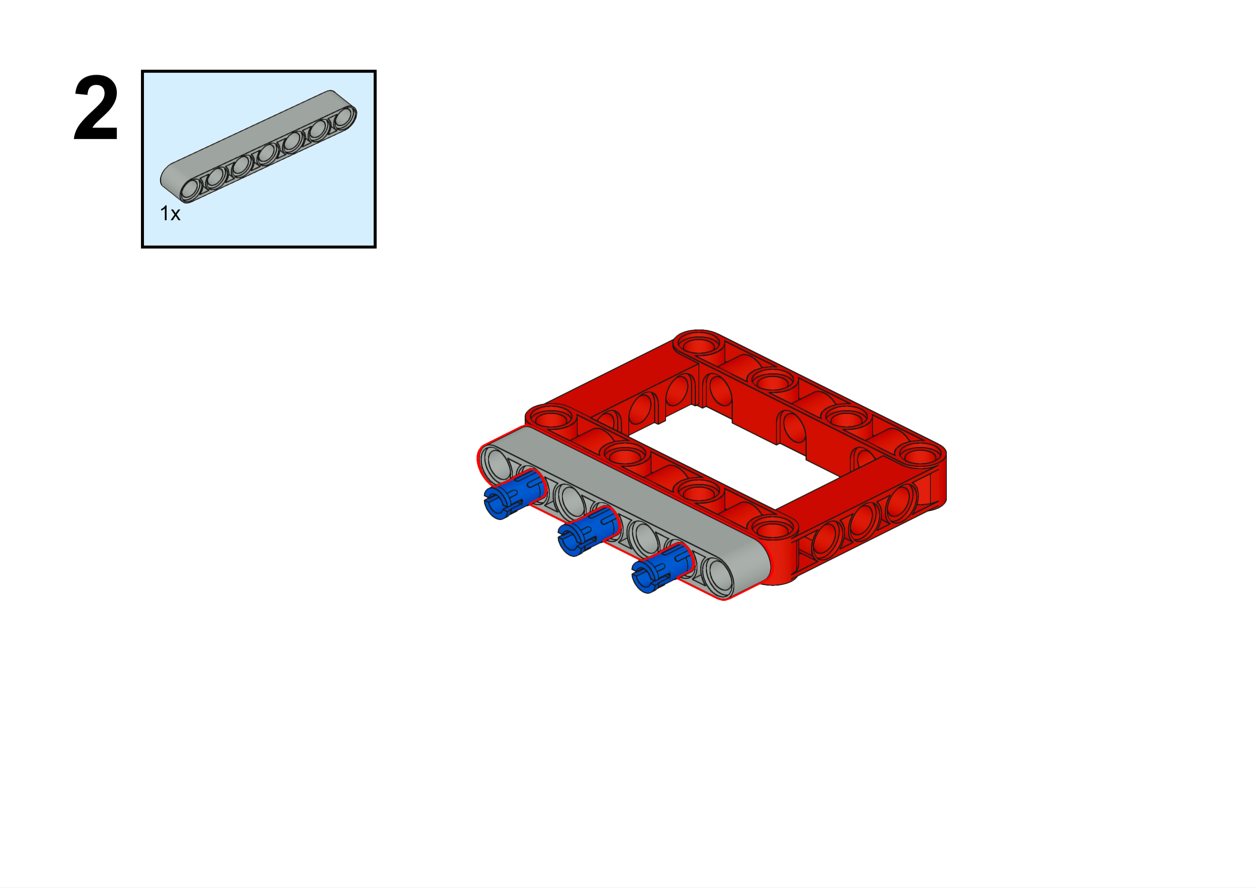
This is called a "beam", but Lego usually calls them "liftarms". You can get this piece from your colored bin of parts. They come in sizes from three to fifteen studs in length, but all odd numbers. However, there is one even numbered beam. Do you know which one? Hint: this is sort of a trick question. By the way, we also have "beams" that are one stud long. We call them "one-beams"
7L
This beam is seven studs long. We call it a seven-beam.

Slide 5
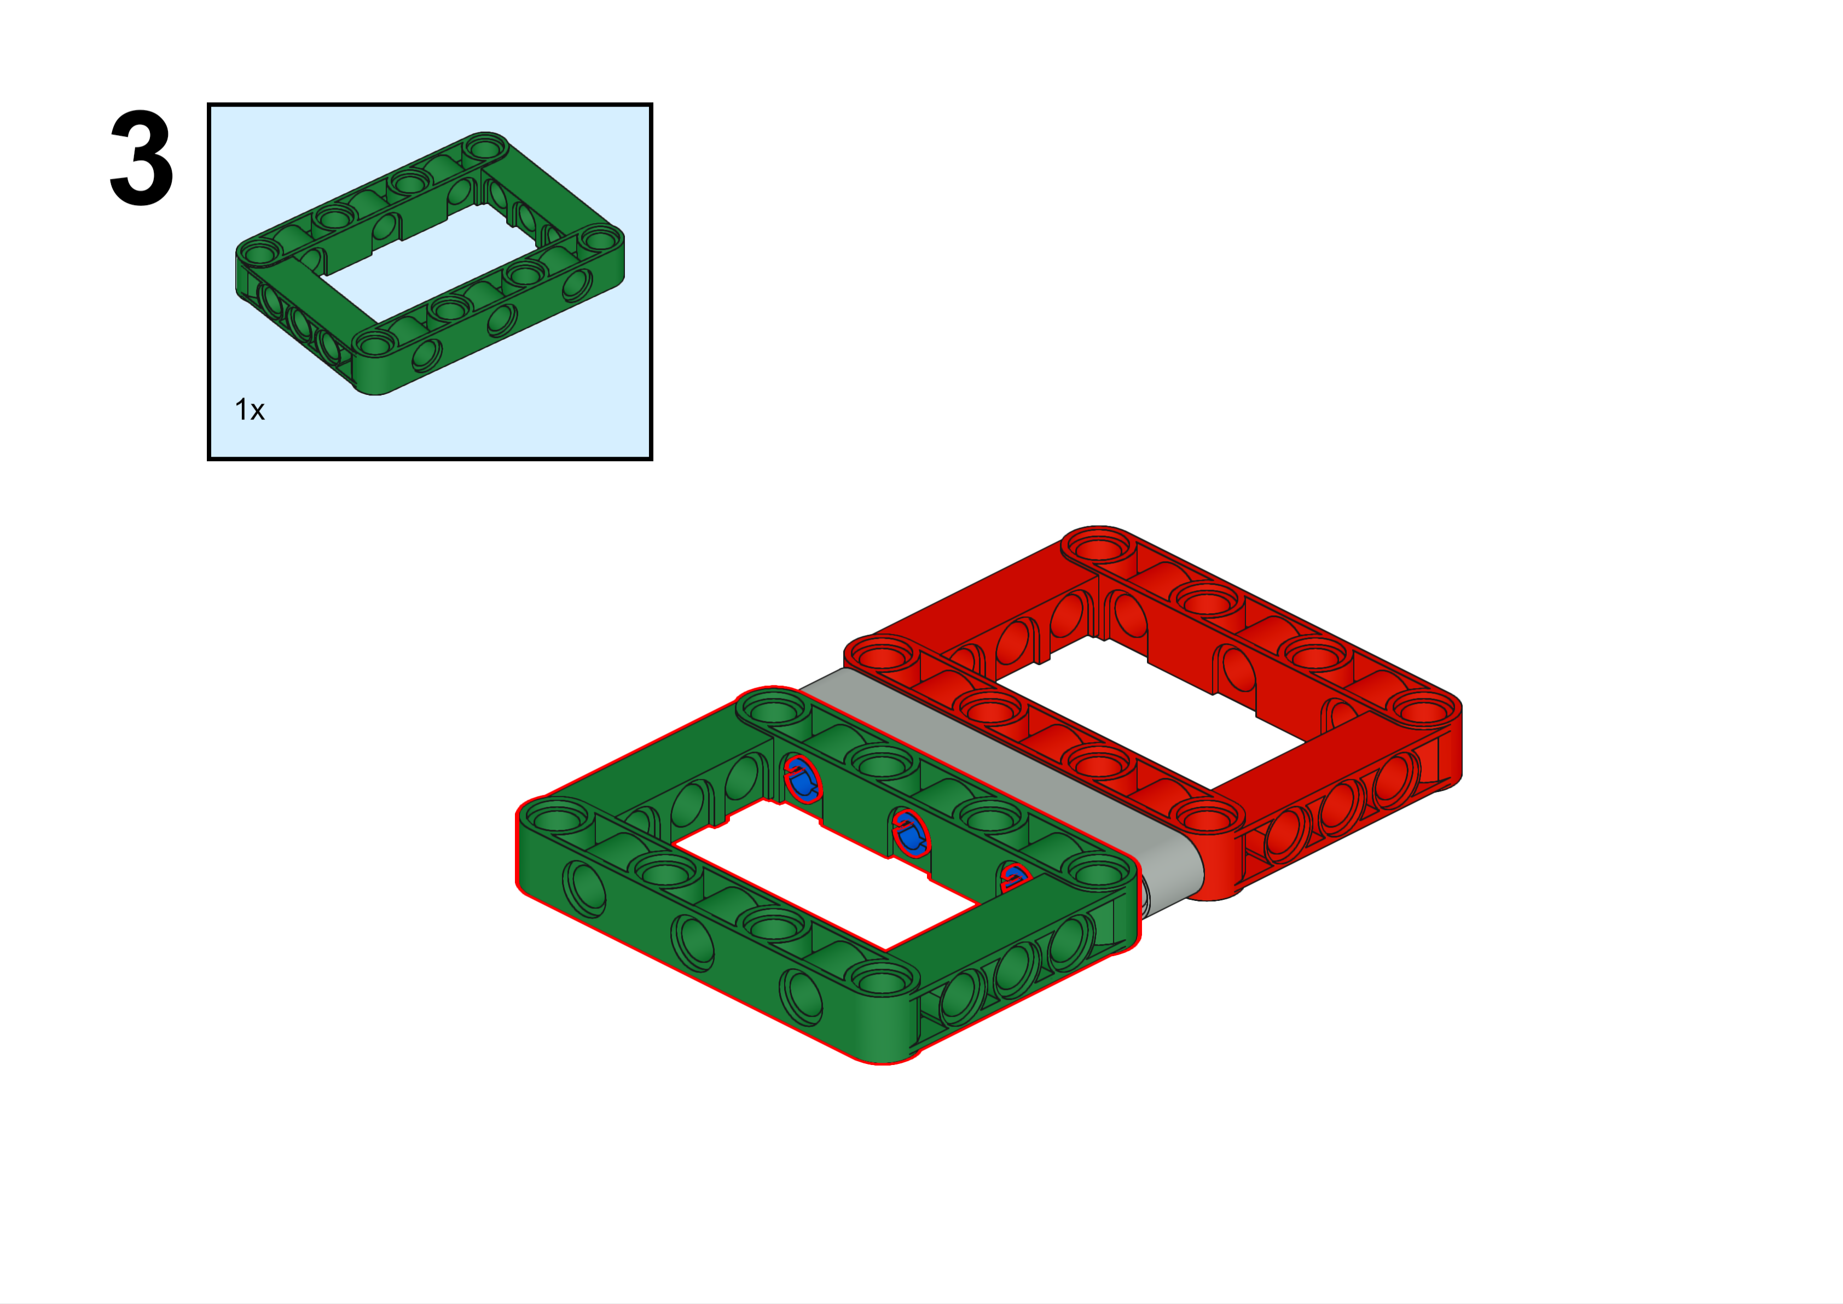

Slide 6
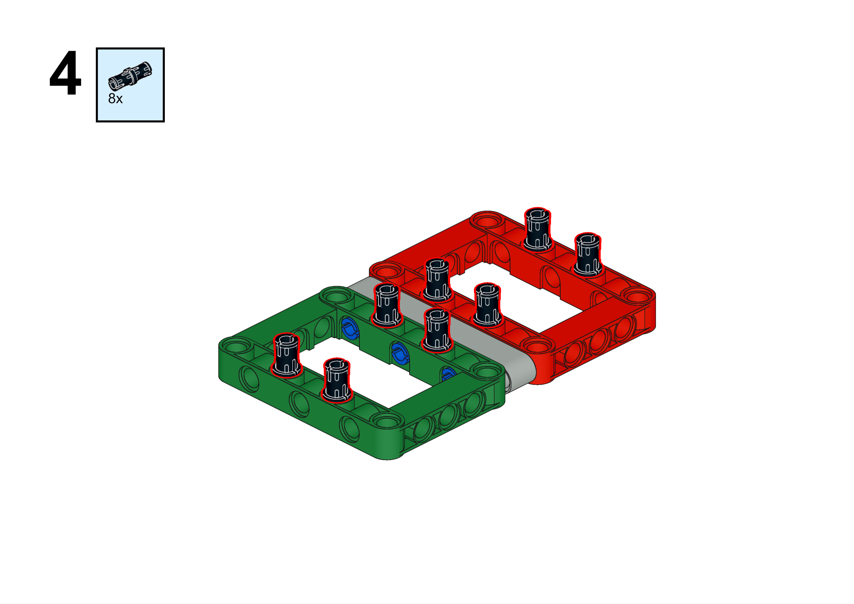
Ahhh.. the black peg. We have over six thousand of them in bins but there is probably one on the floor right now!

Slide 7
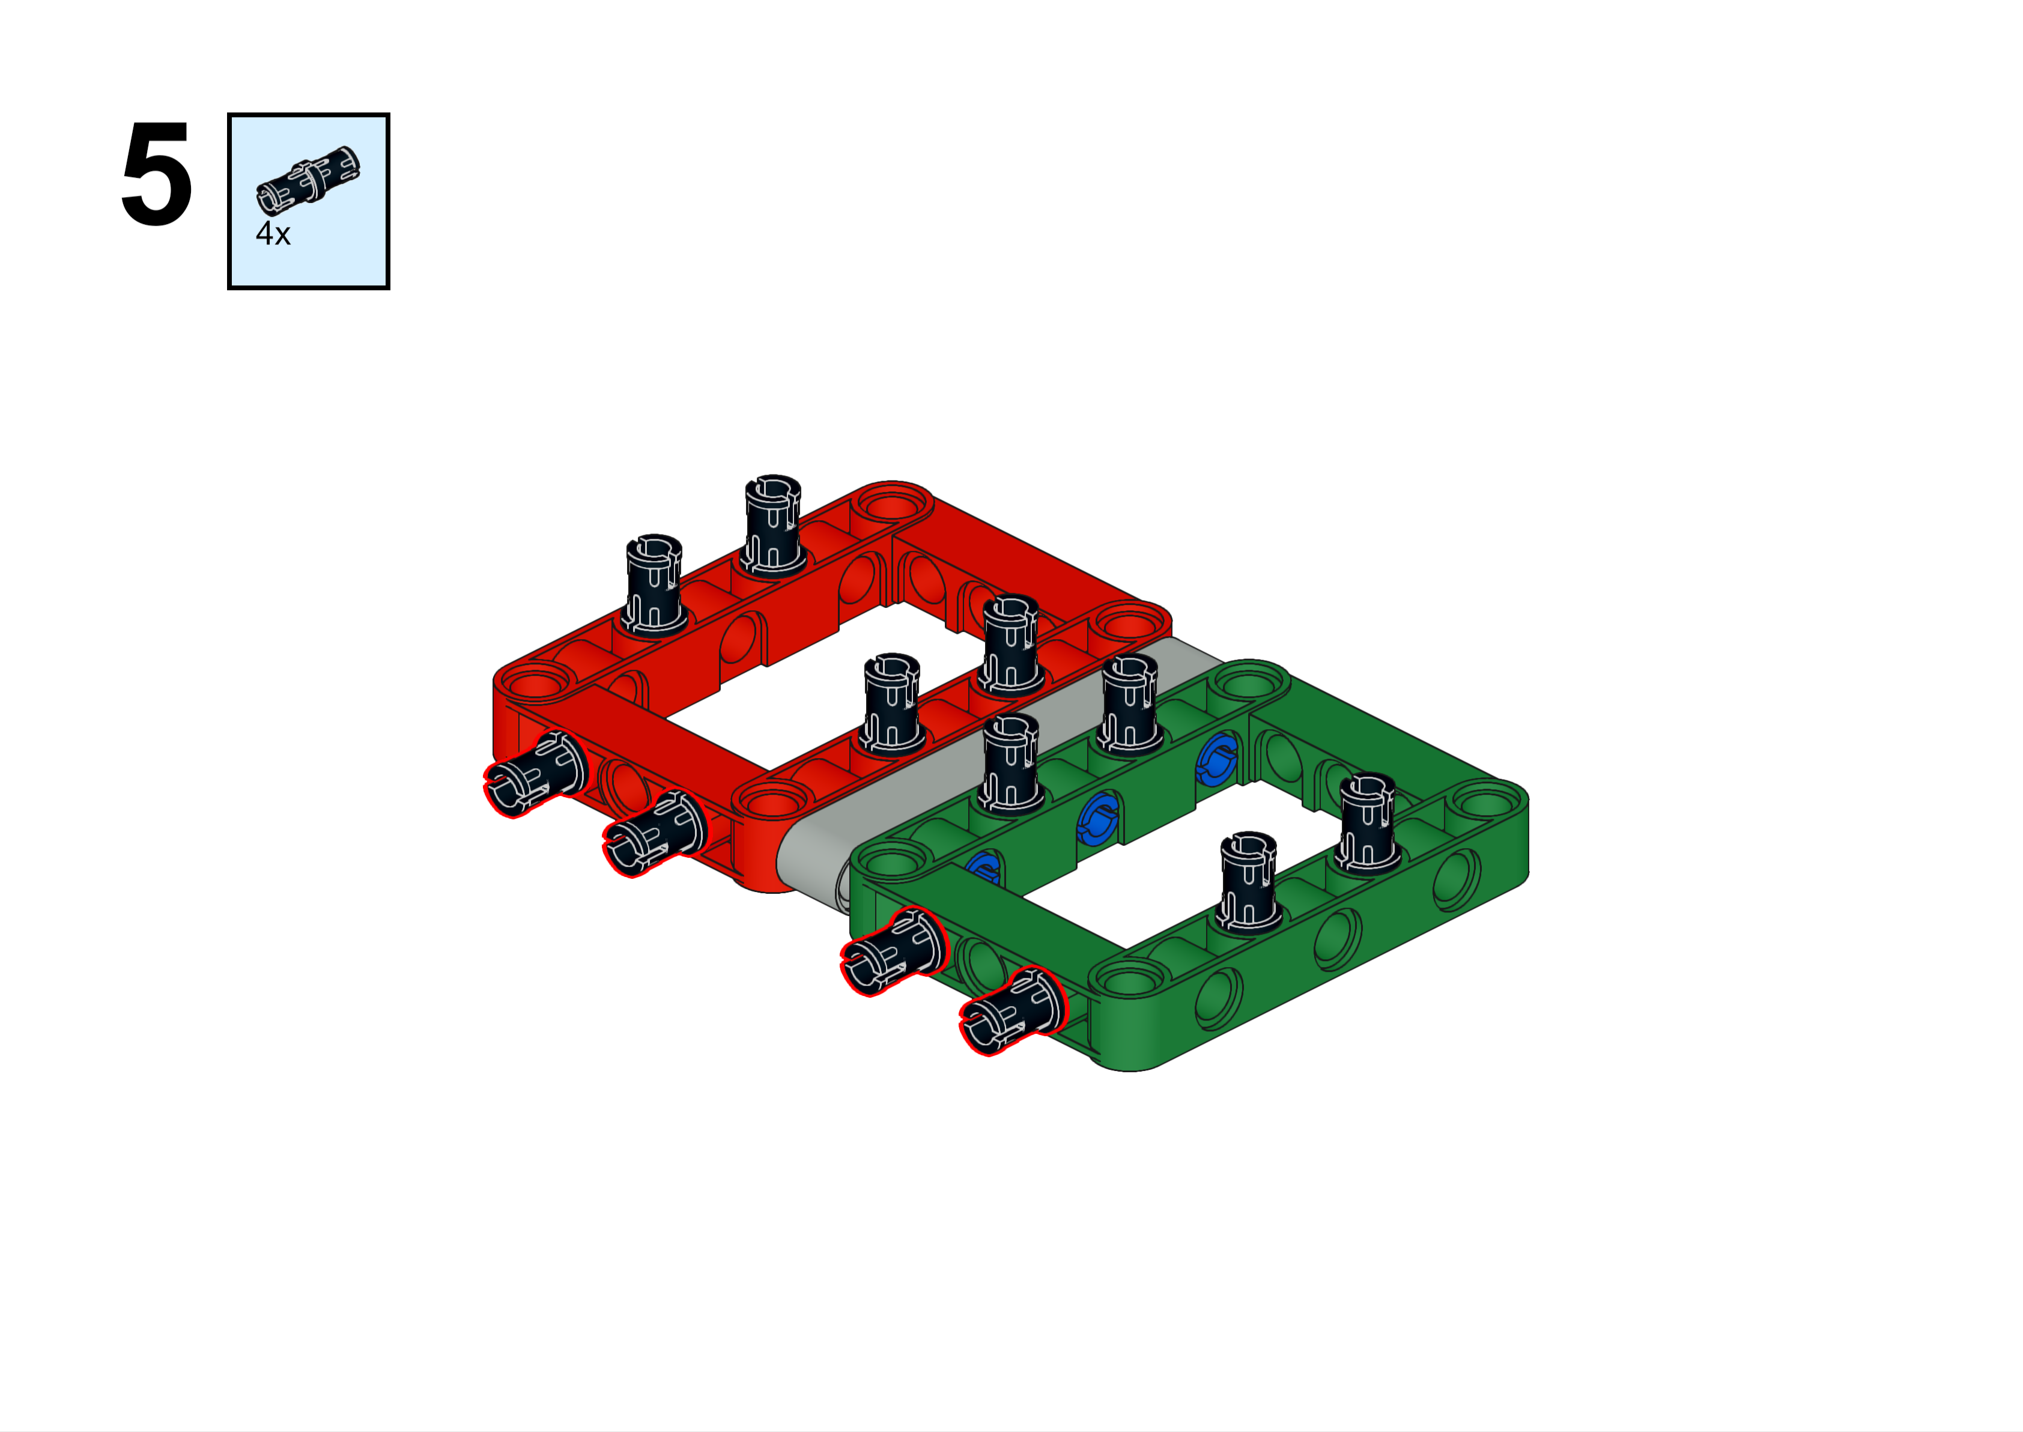
Forward

Slide 8
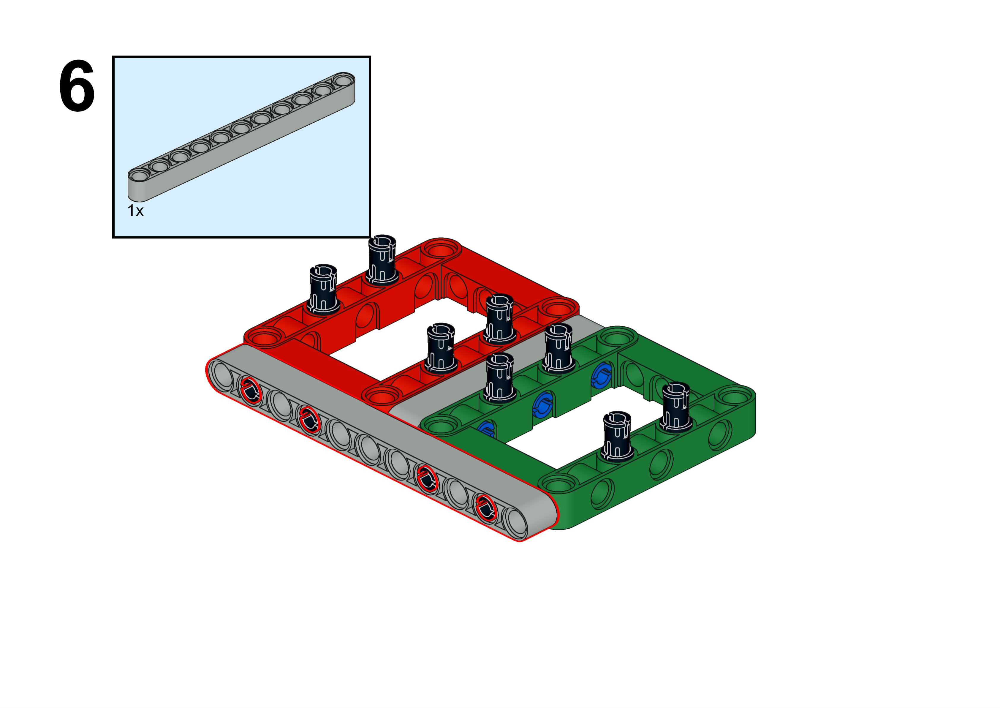
Forward

Slide 9
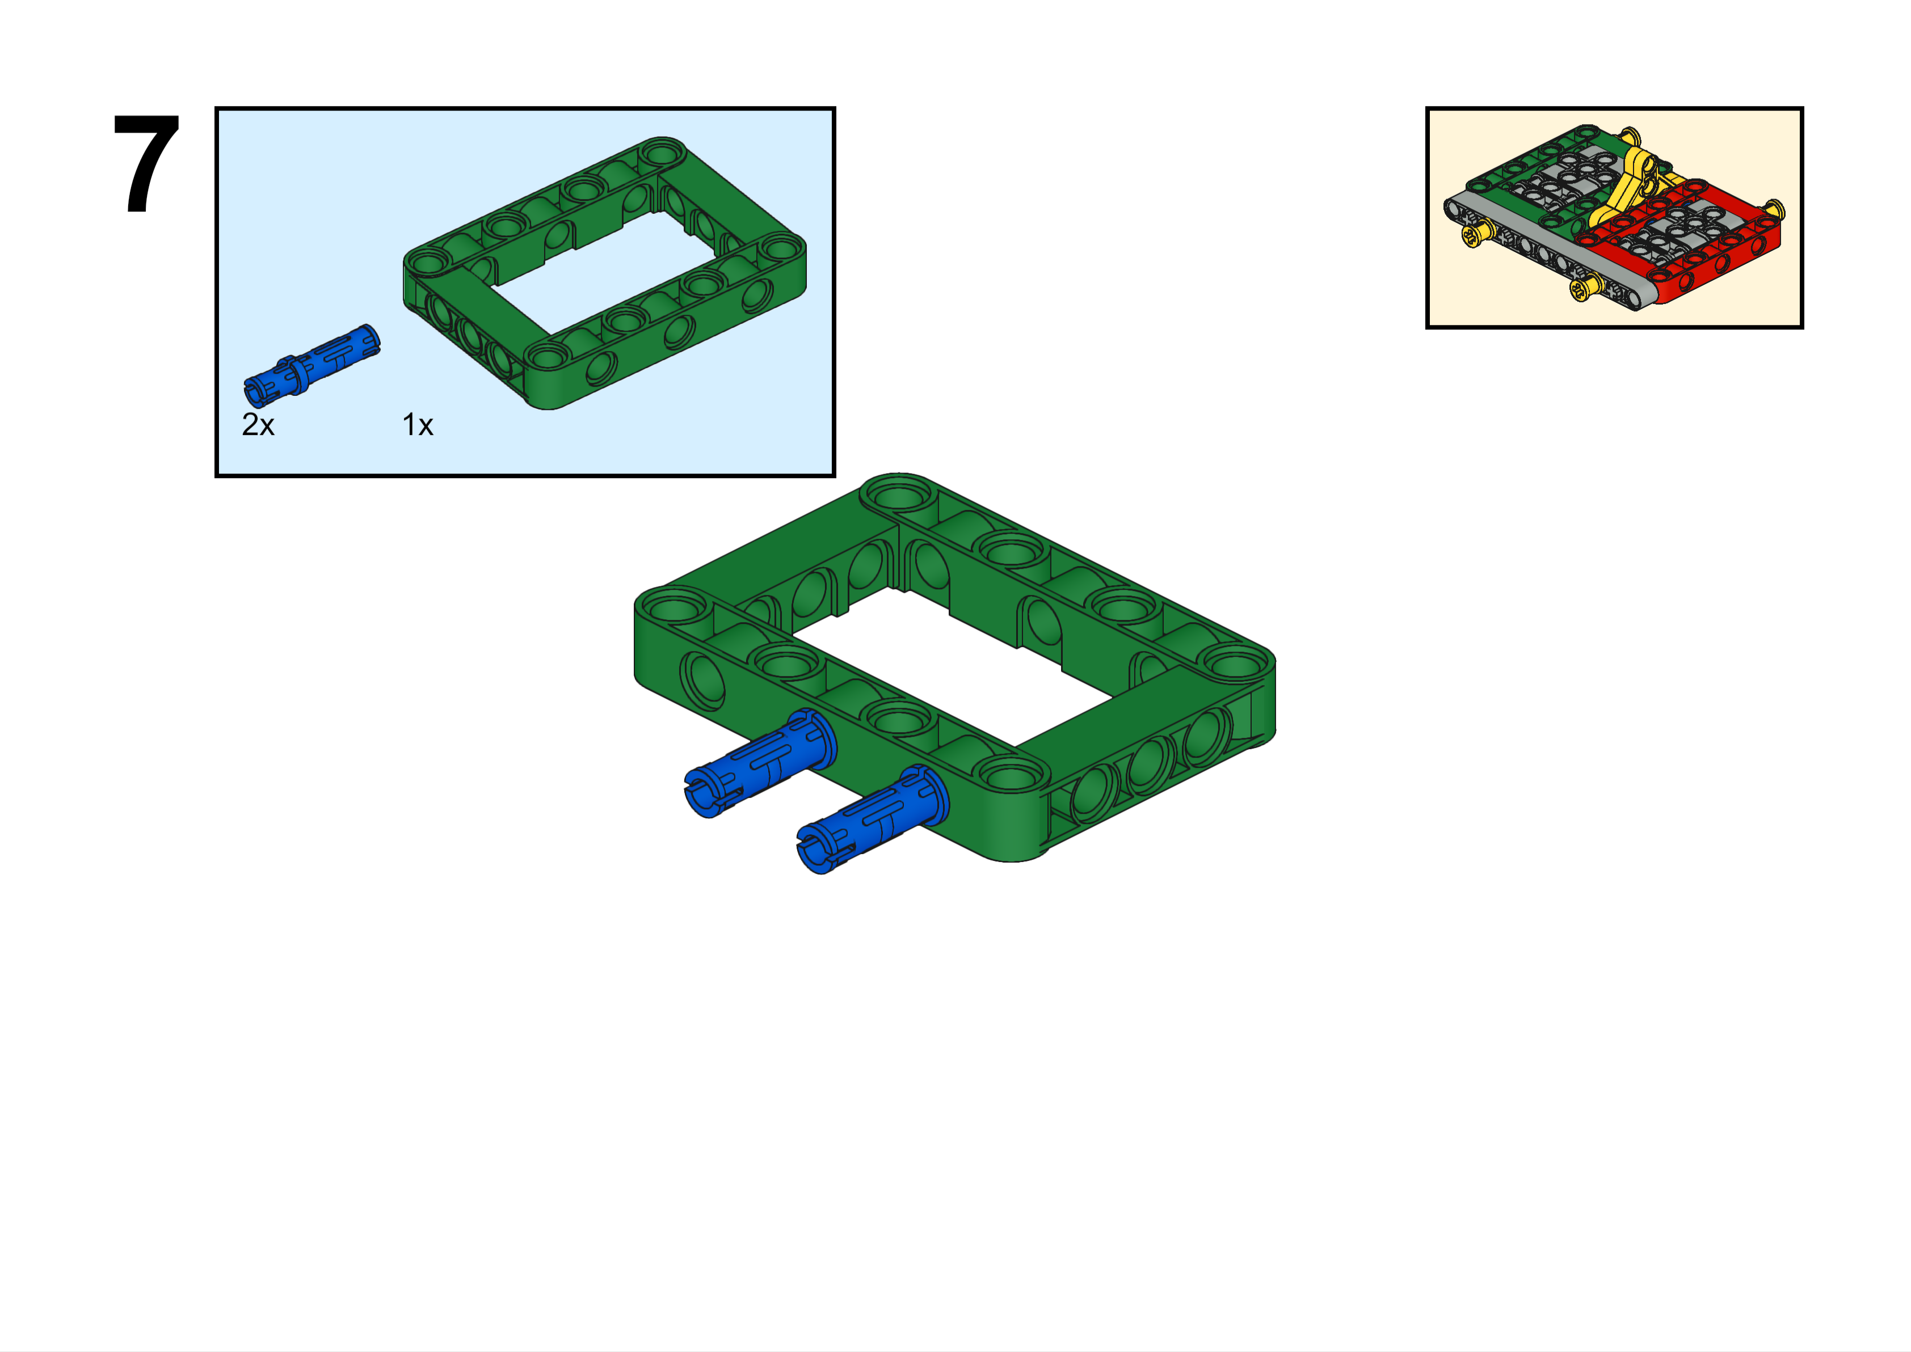

Slide 10
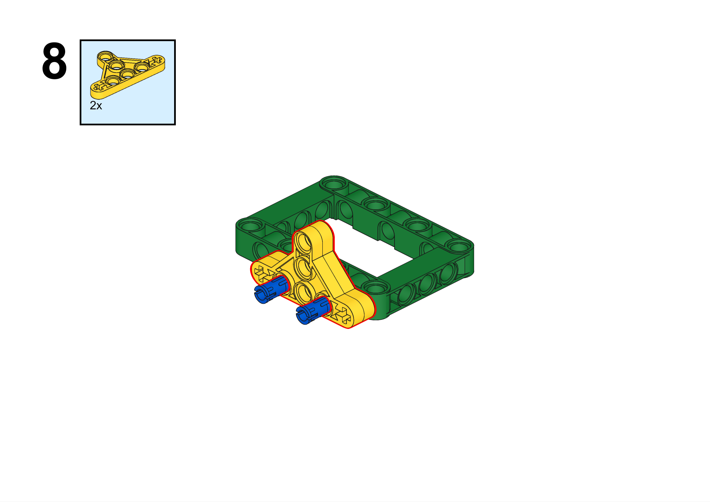

Slide 11
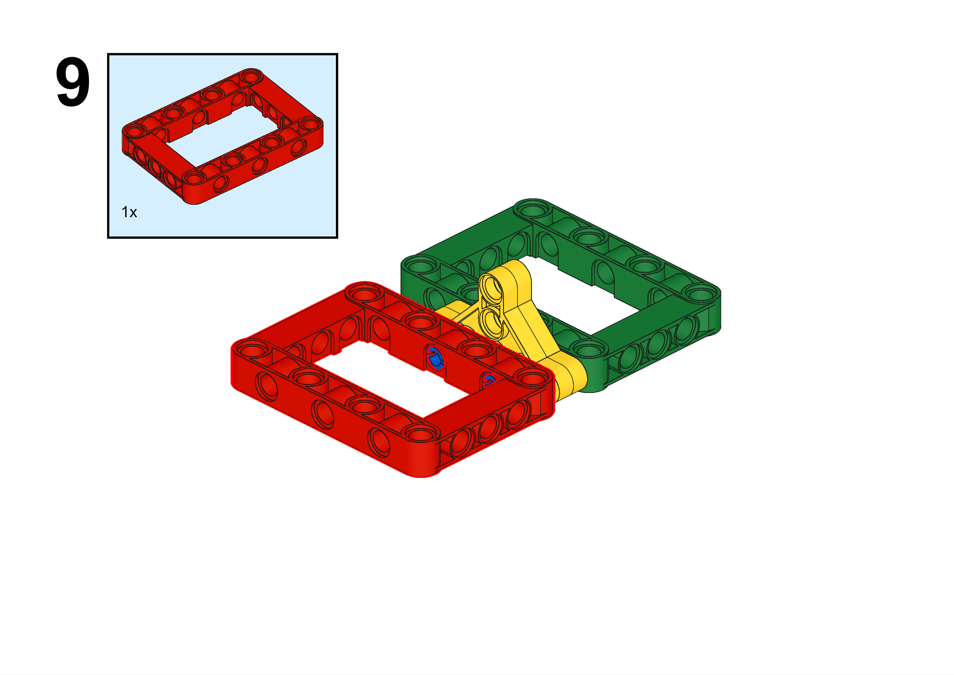

Slide 12
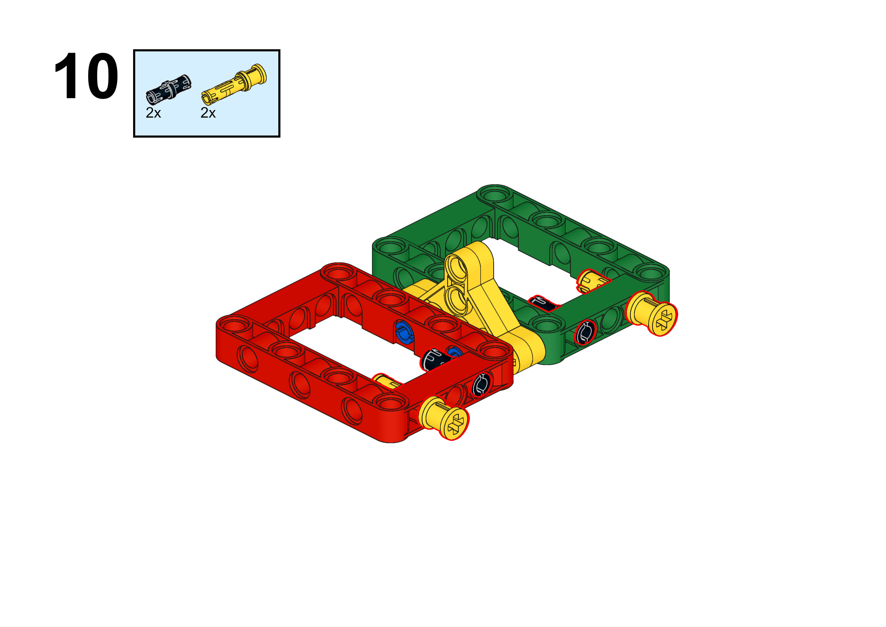
We call this yellow piece a “push pin”.

Slide 13
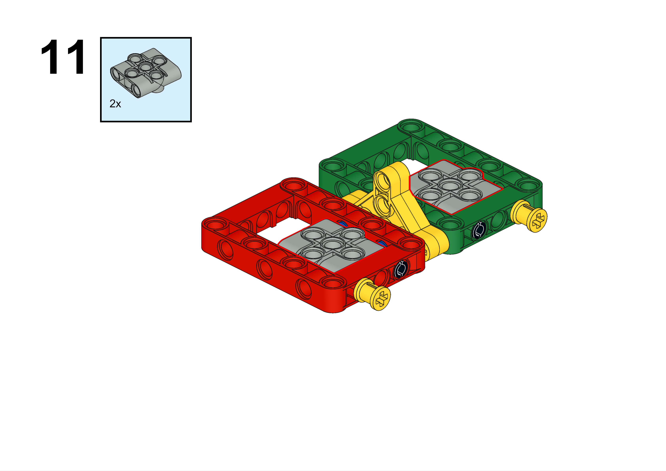

Slide 14
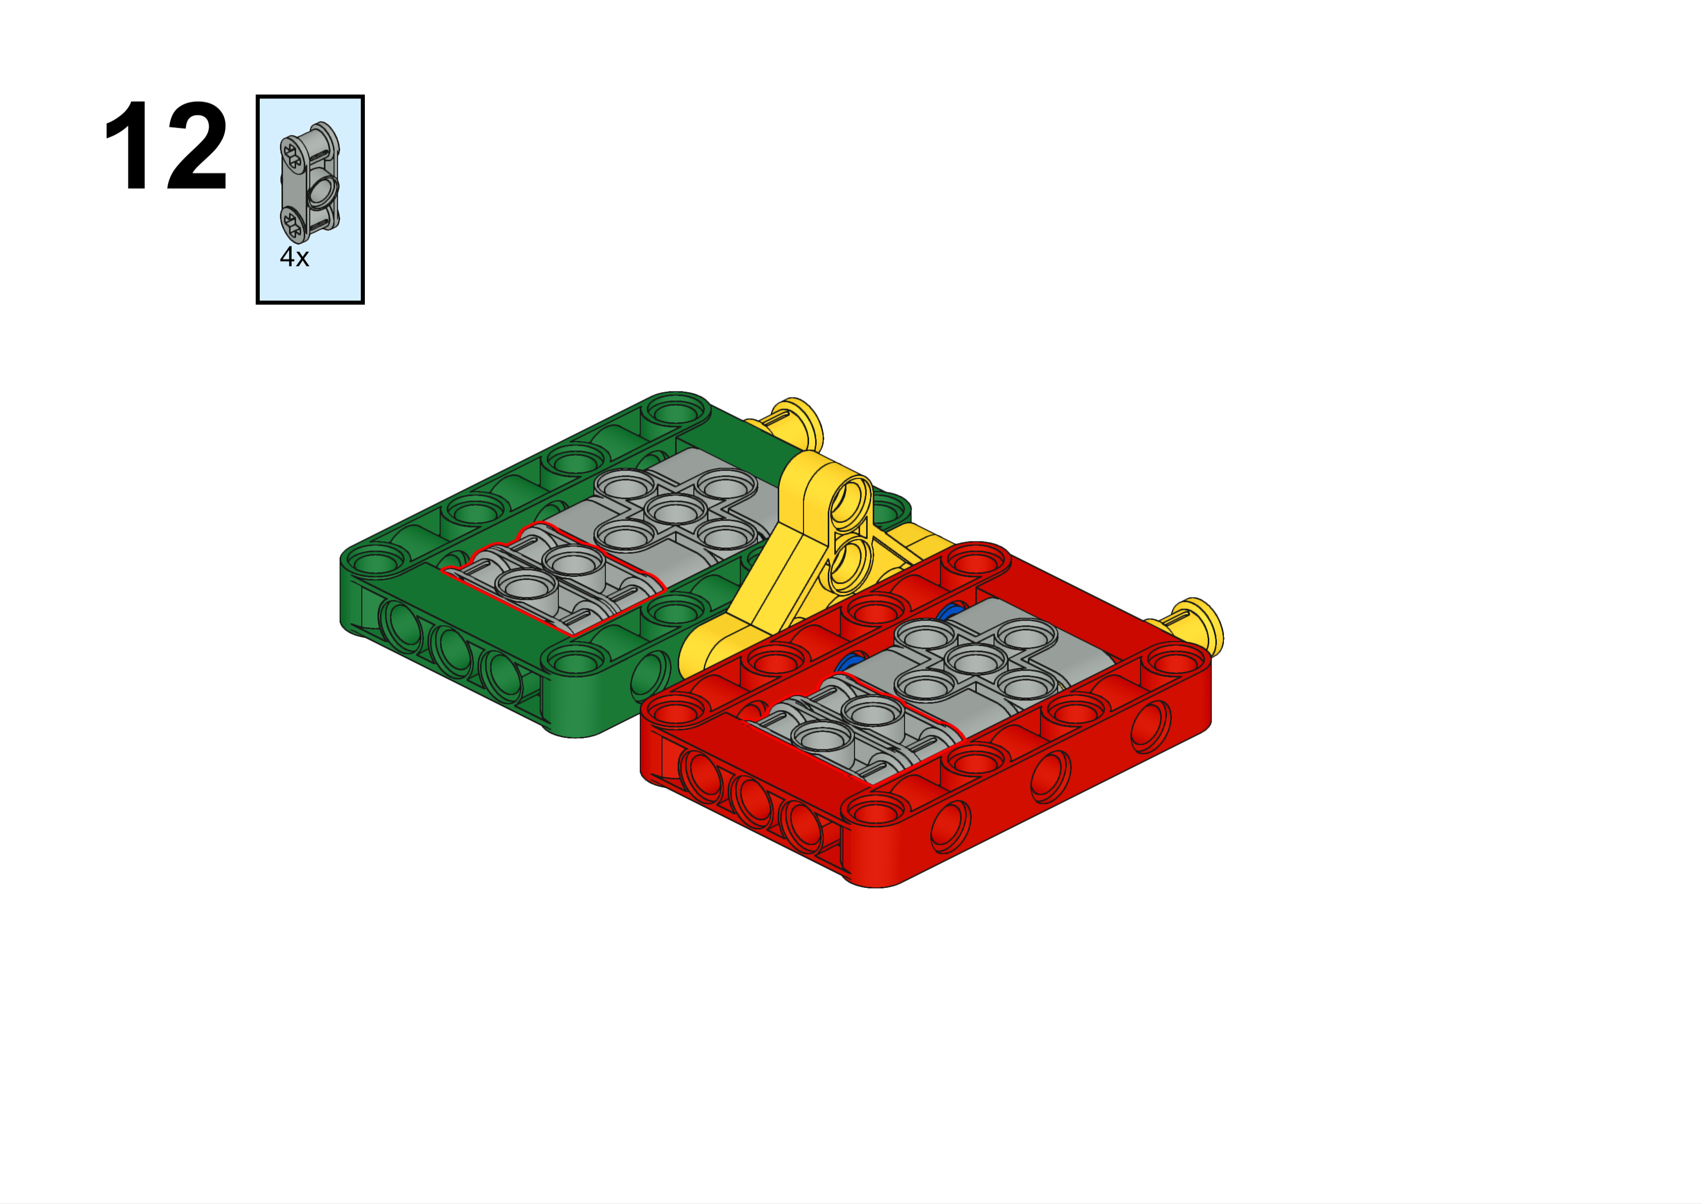
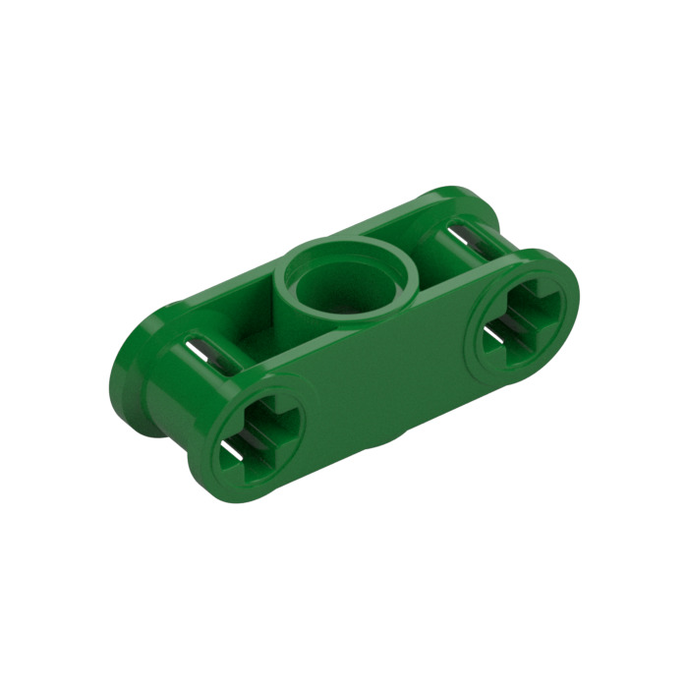
These won’t stay in place until you complete the next step. So just get the pieces you need for now.
This is a better picture of the piece you are looking for
Forward

Slide 15
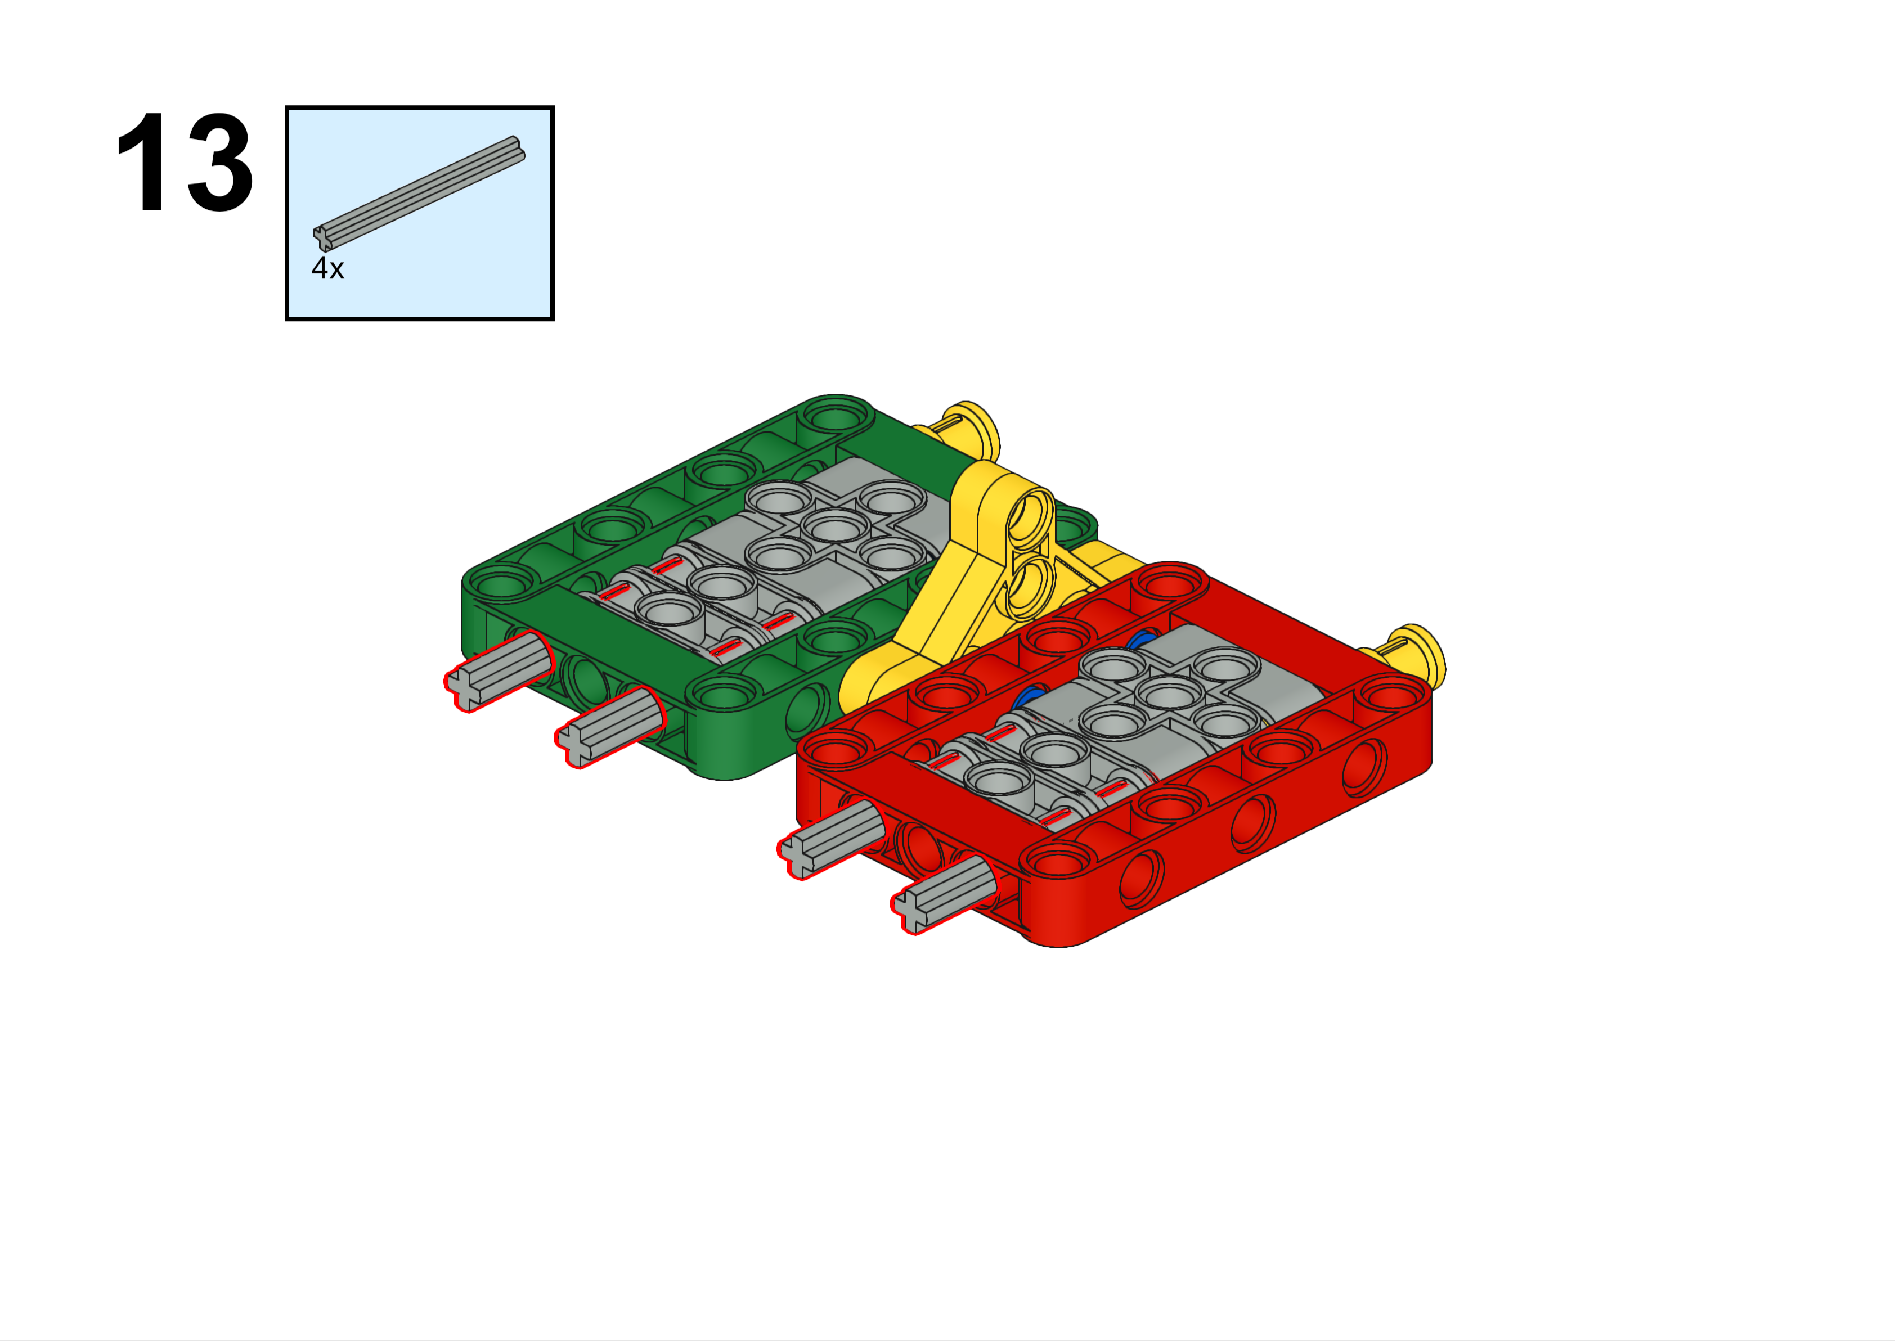
This piece is called an "axle". We normally use them to connect rotating pieces, but in this case we are using them for structure and support. Axles come in sizes from two to twelve studs in length, plus some other really long ones. We have all kinds of connectors to make any size or shape you need.
5L
Axles will stick out here just like the picture shows
Forward

Slide 16
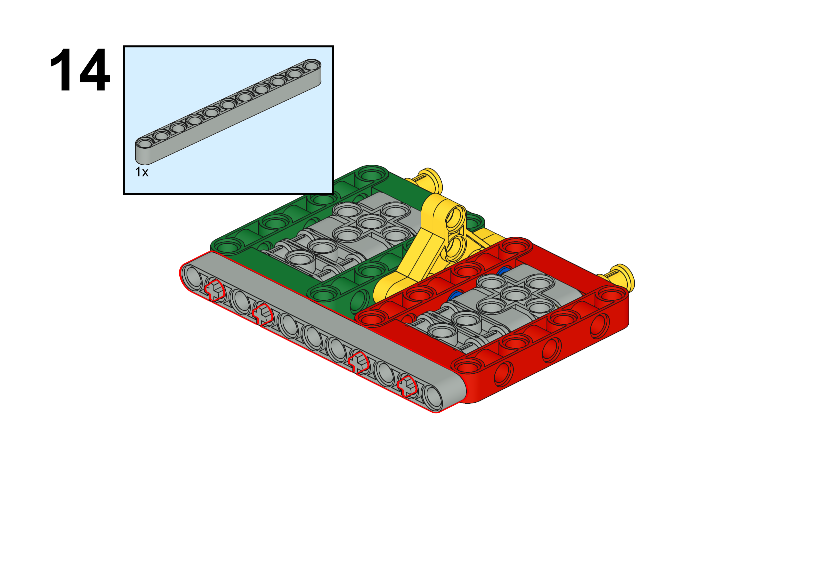
Forward

Slide 17
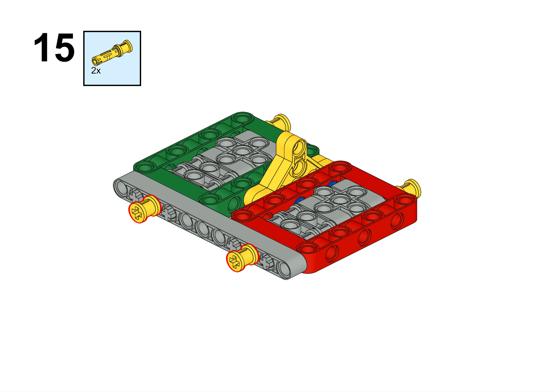
Forward

Slide 18
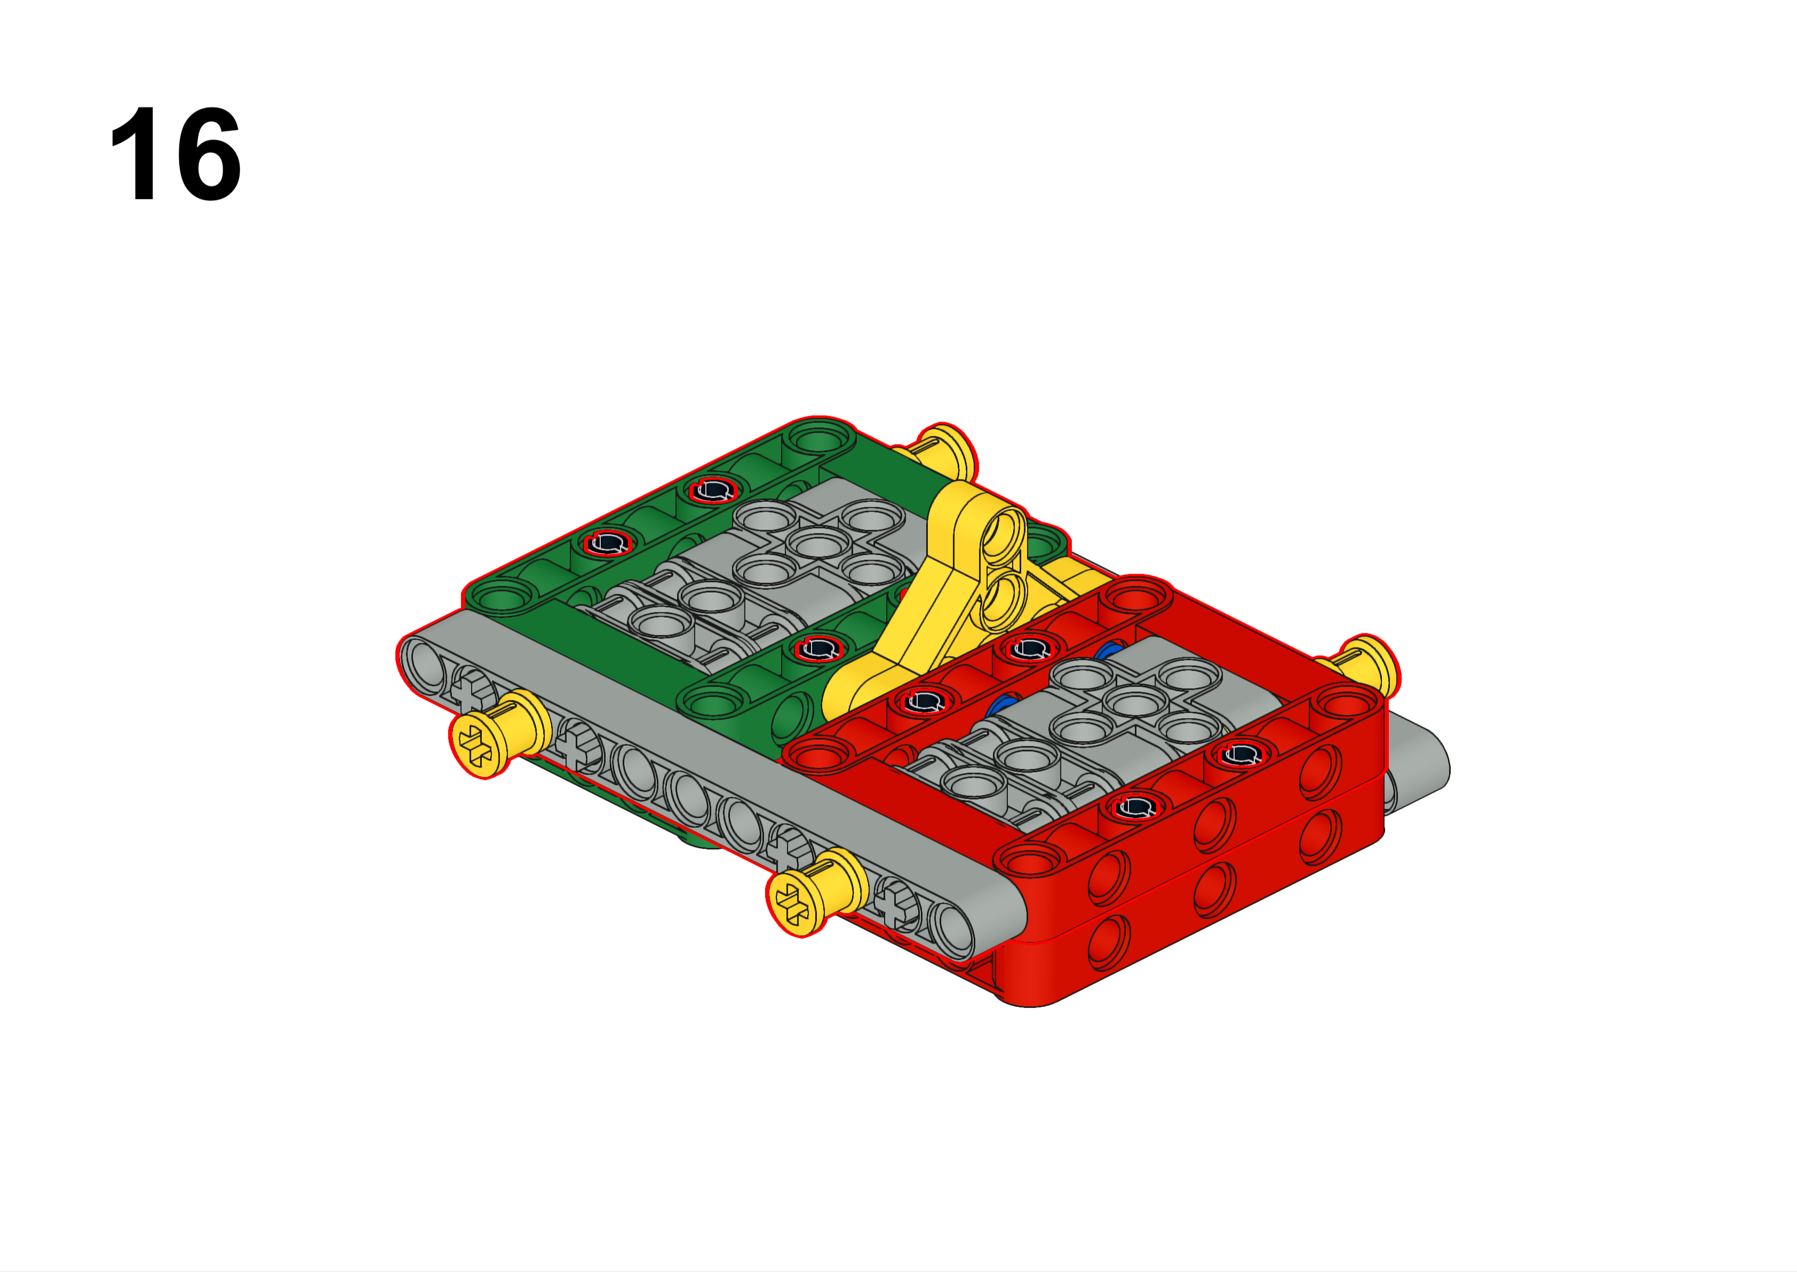
Forward

Slide 19
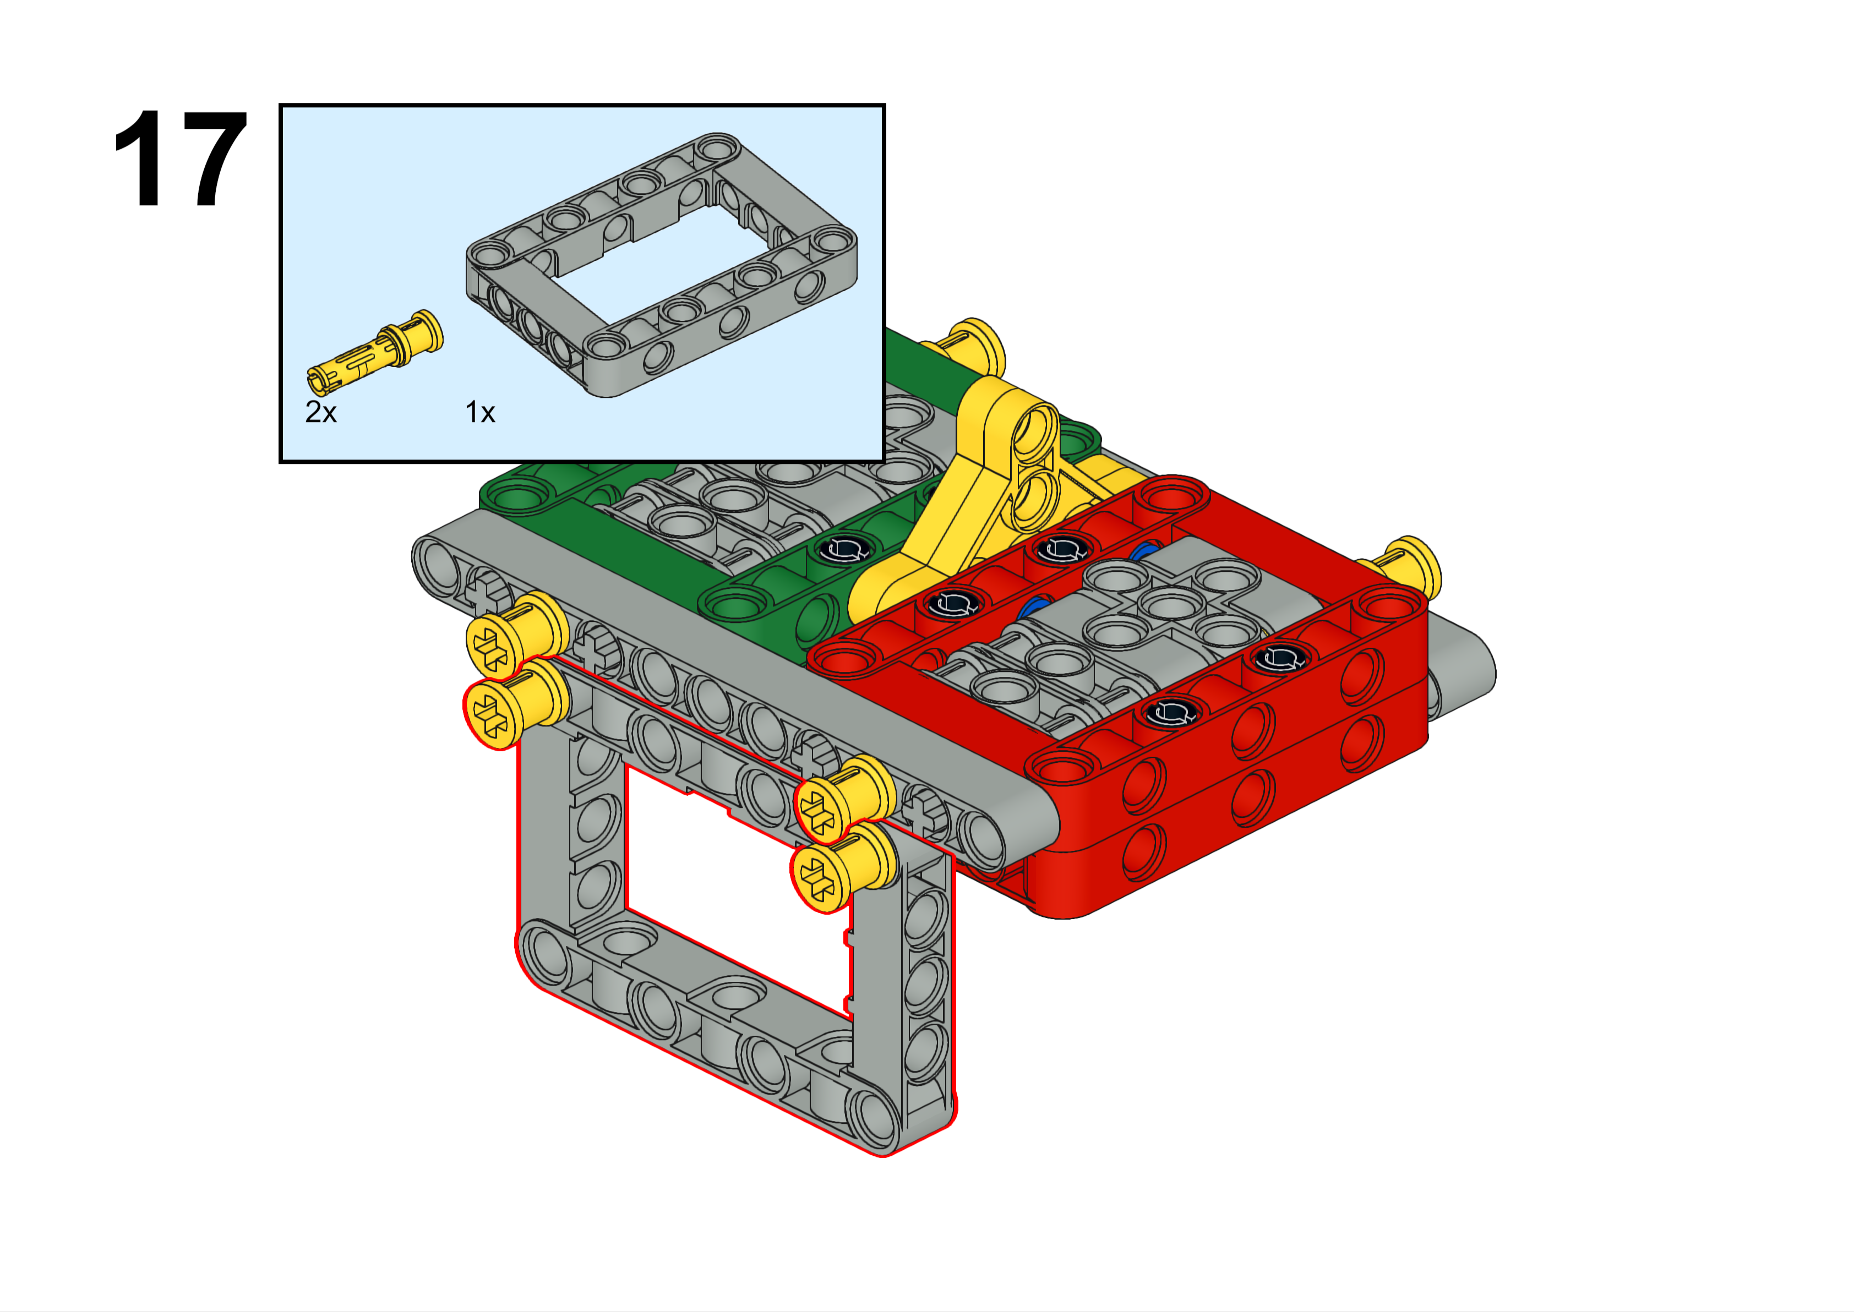
This frame is very important, but you may not fully understand its purpose until we get closer to the tournaments.
Forward

Slide 20
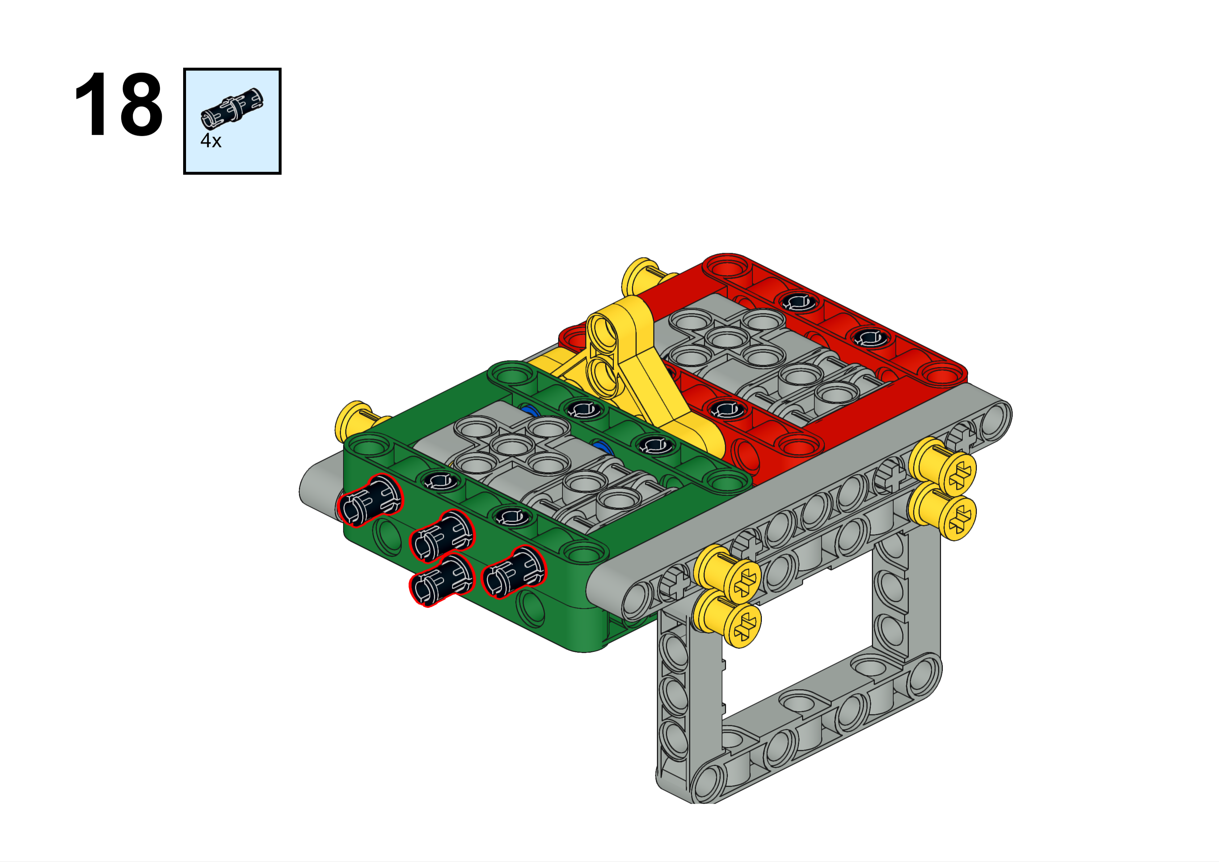

Slide 21
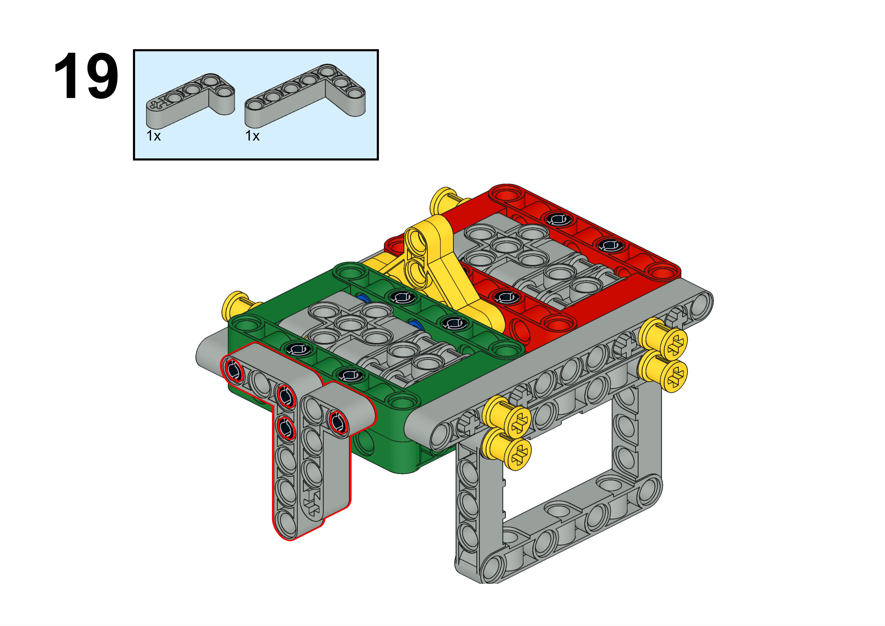

Slide 22
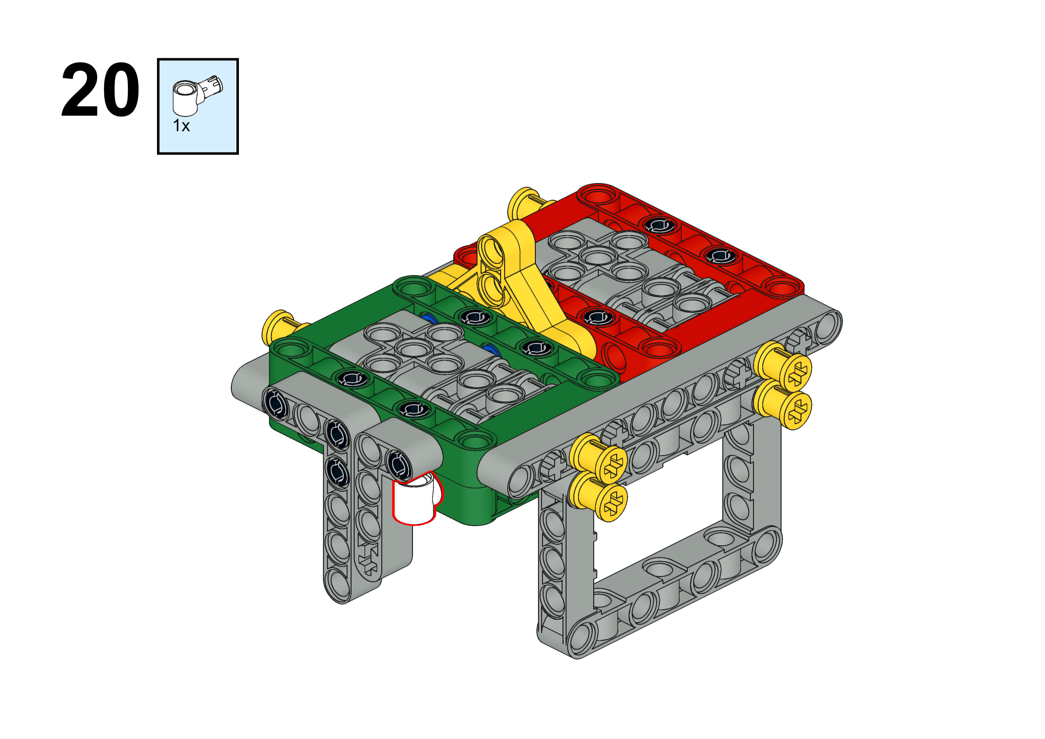
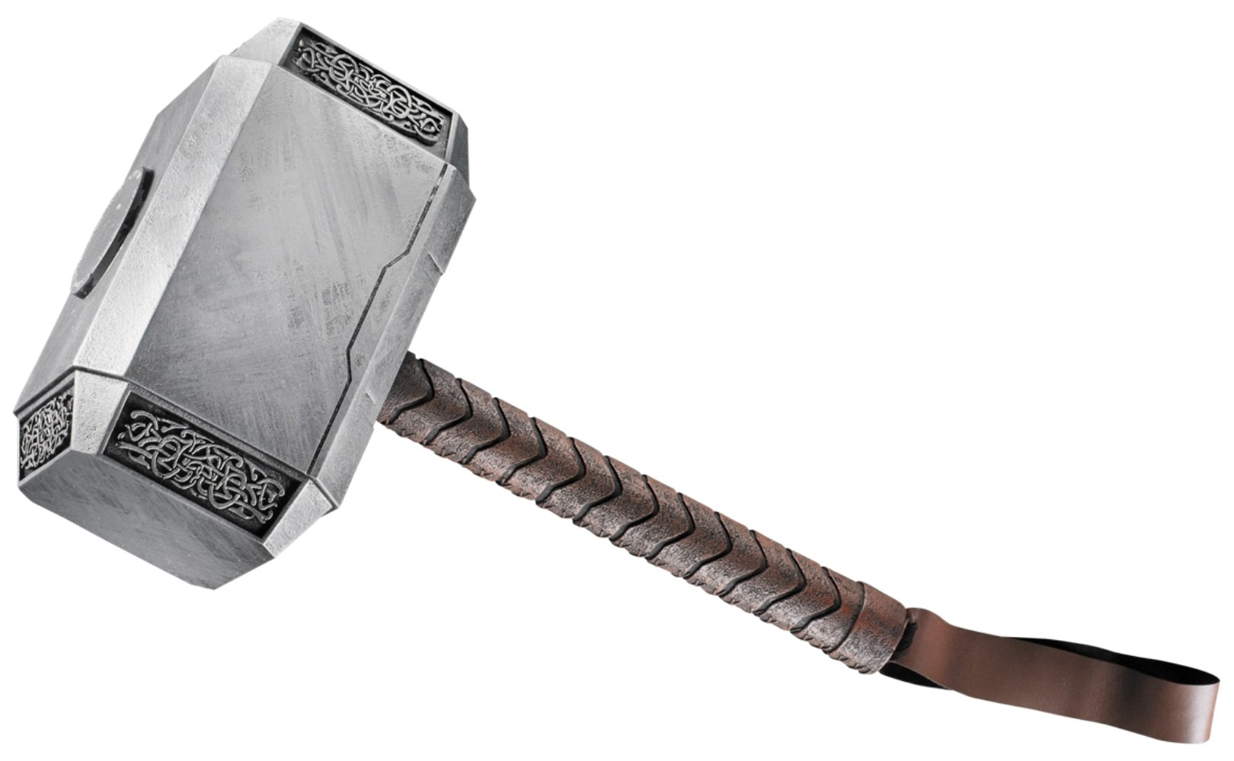
We call this piece a “hammer”.

Slide 23
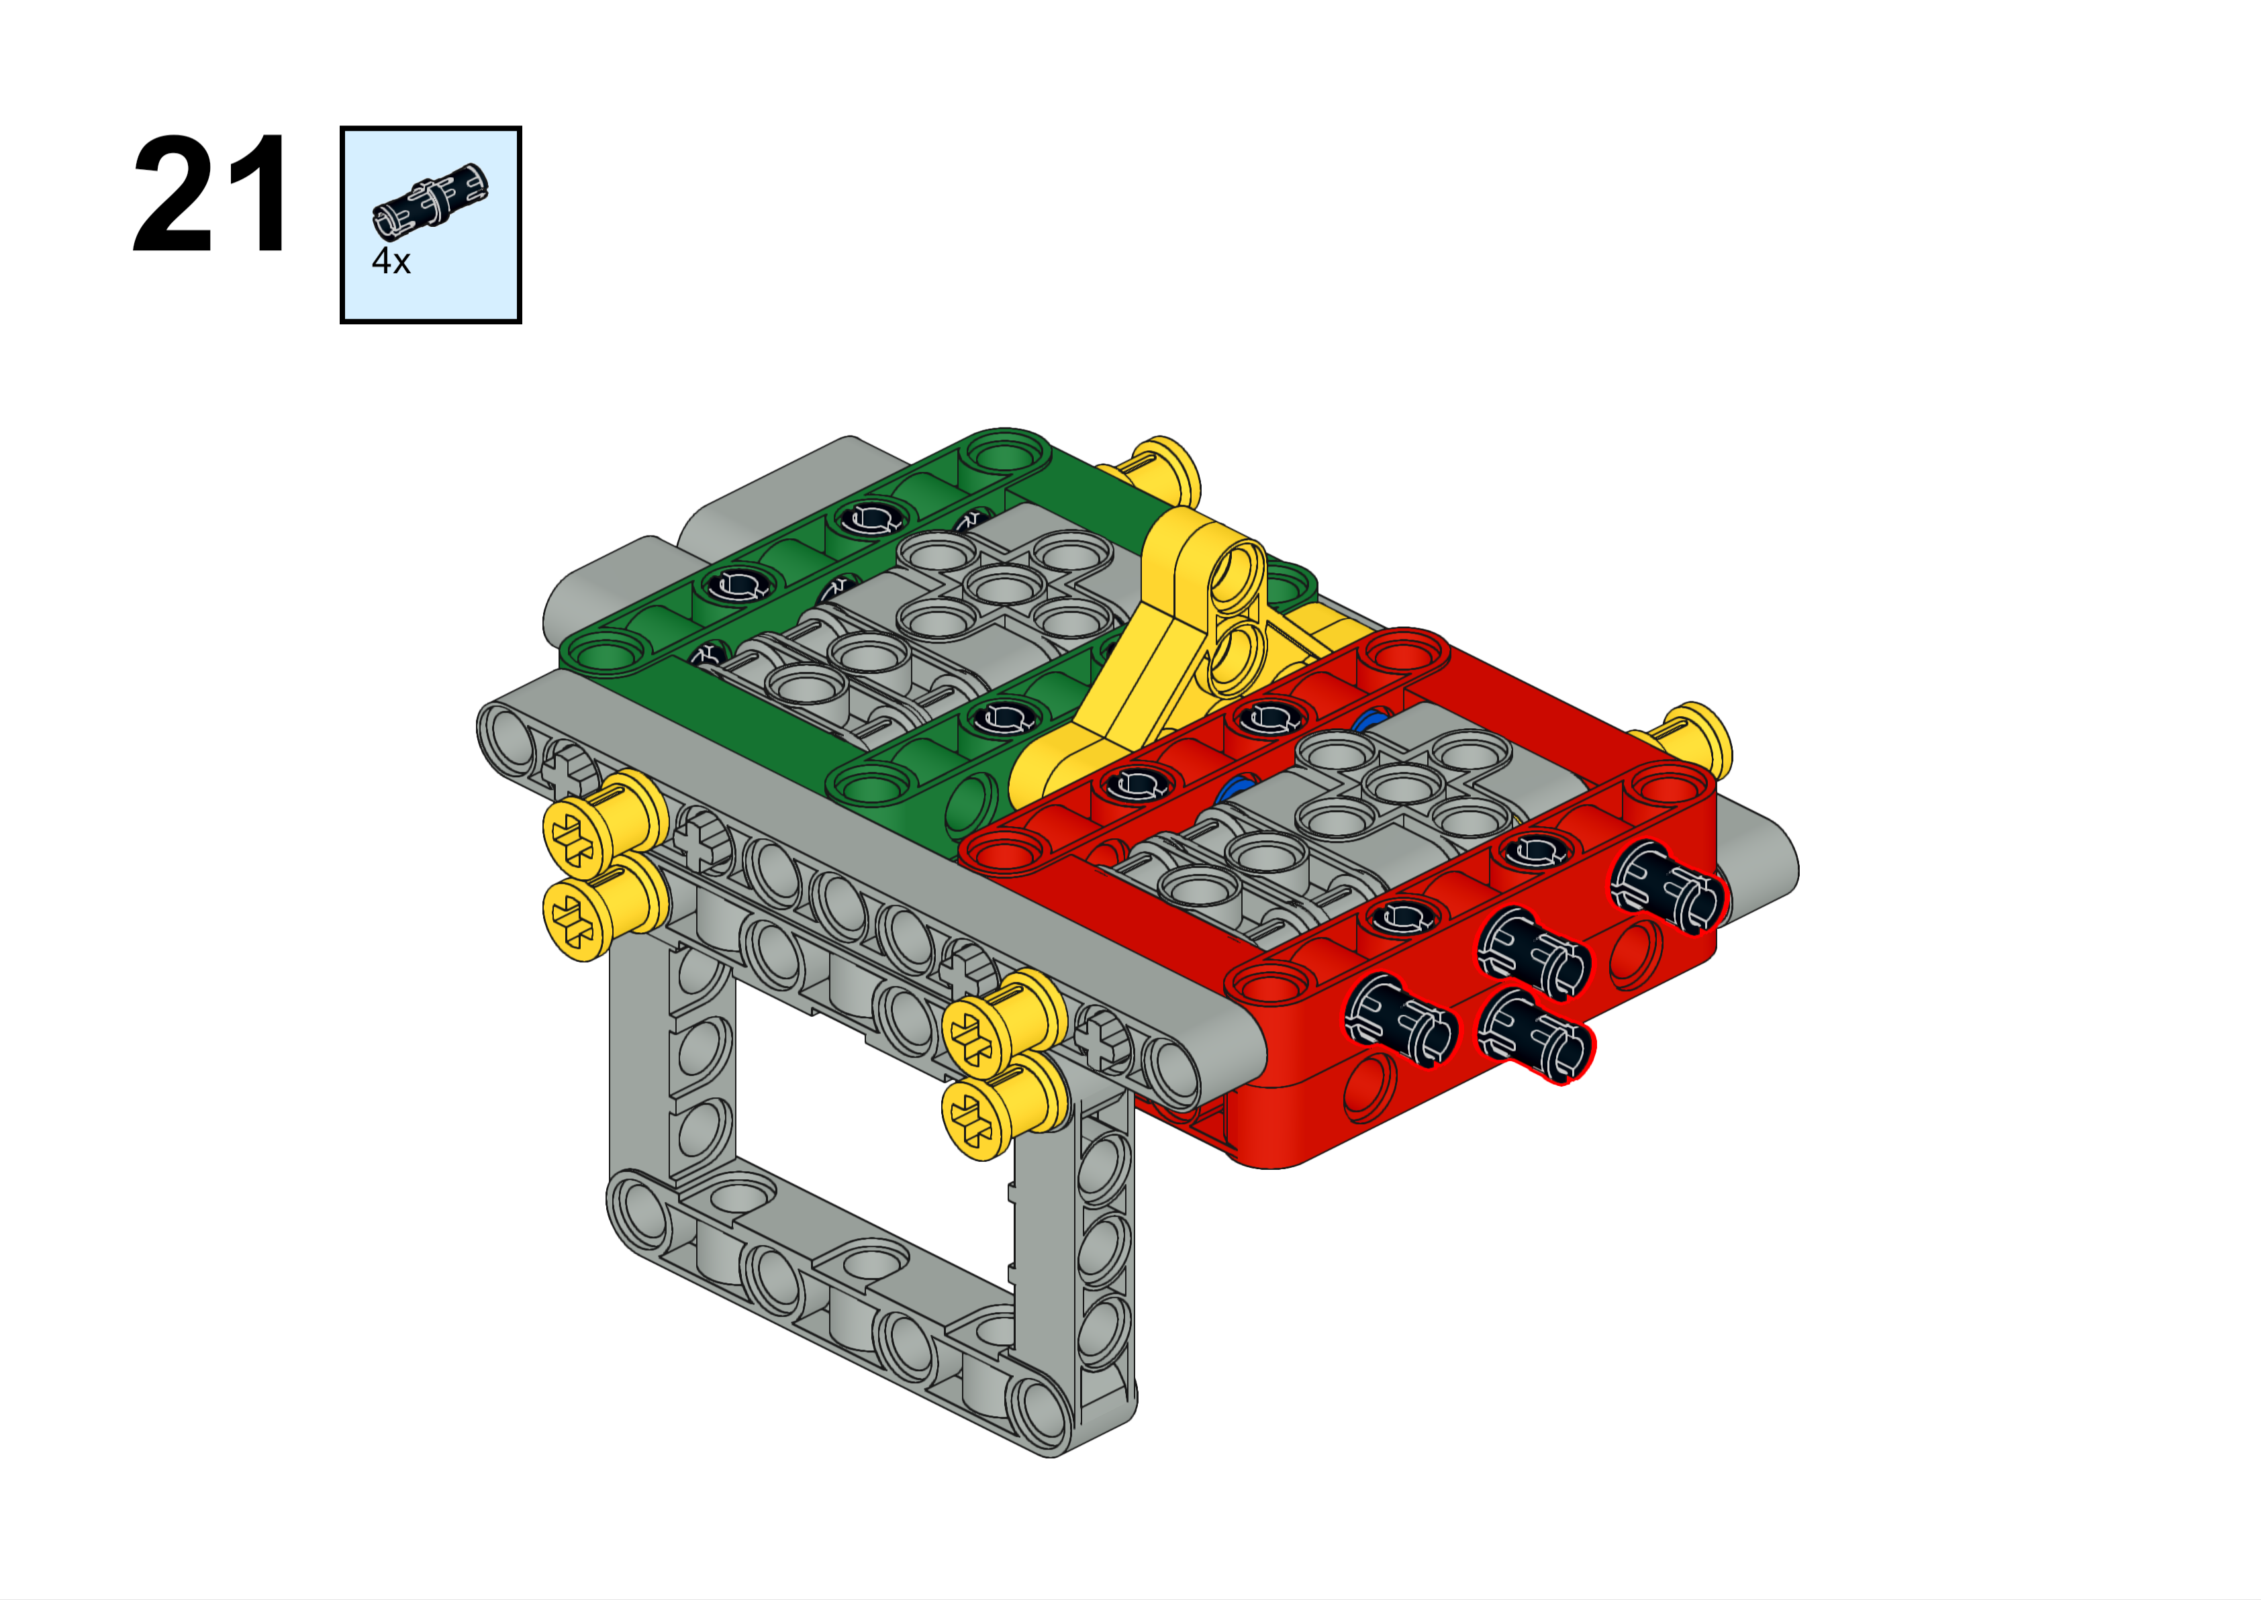

Slide 24
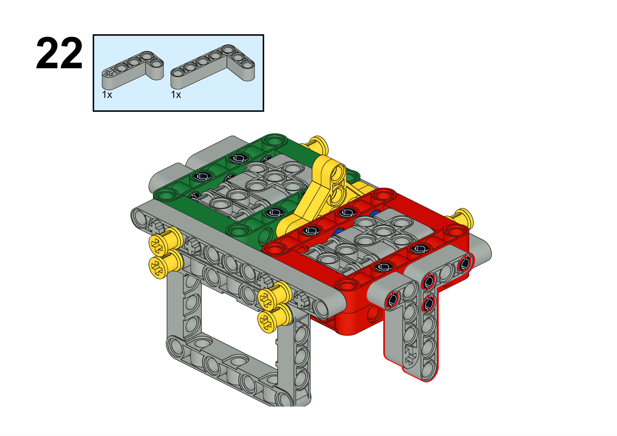

Slide 25
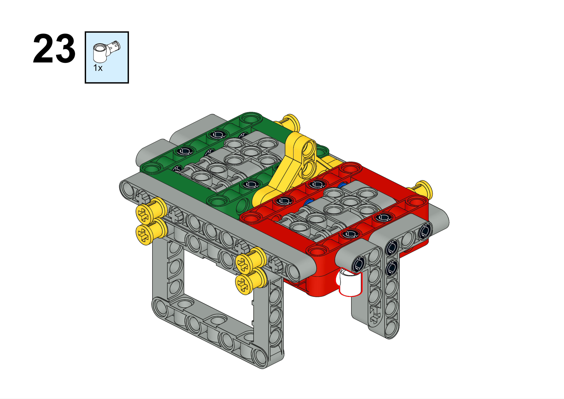

Slide 26
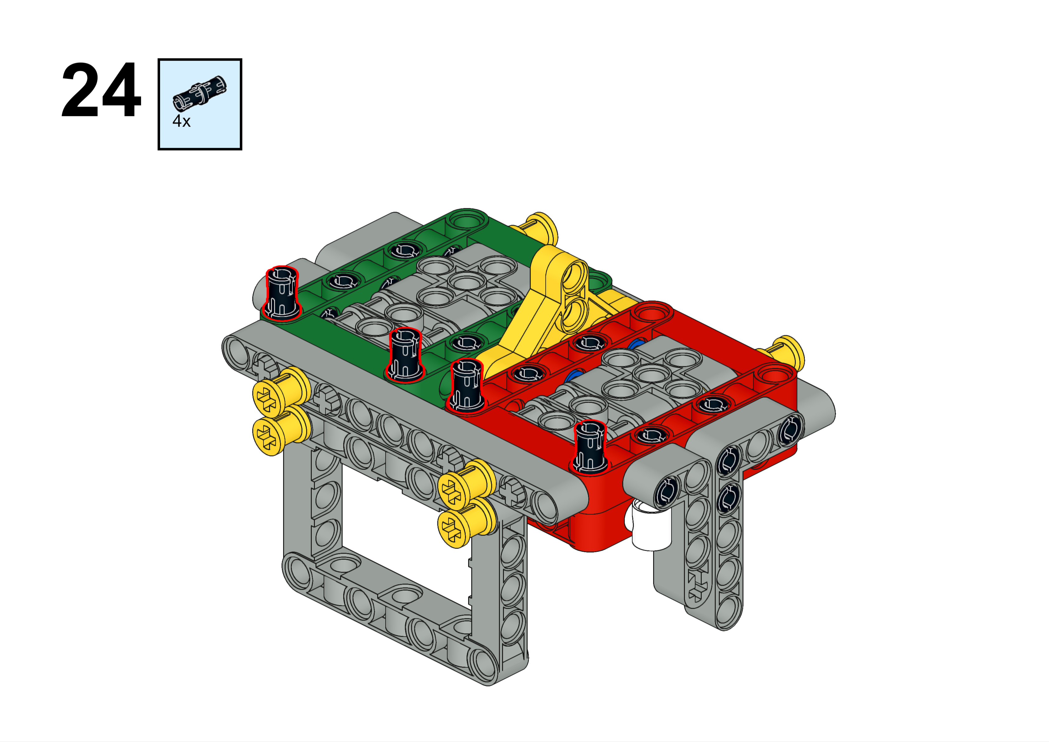

Slide 27
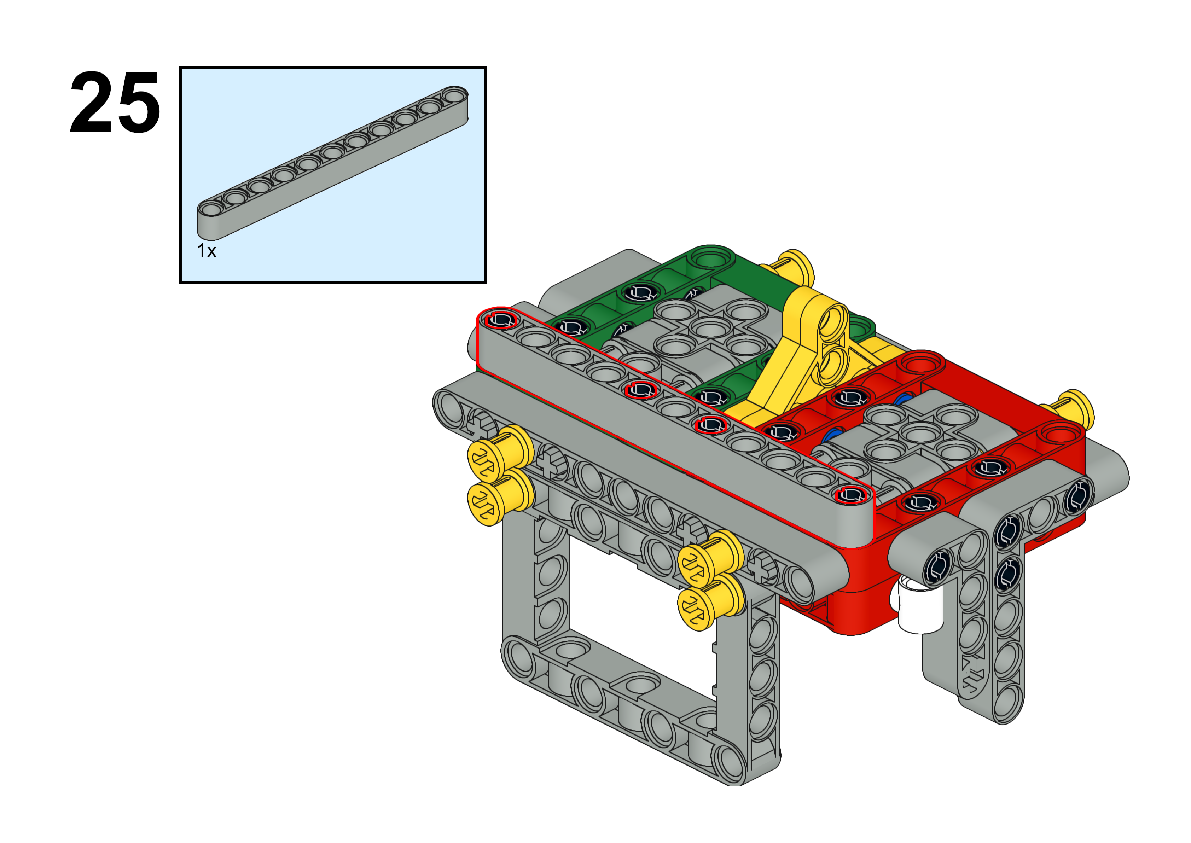
11L
Forward

Slide 28
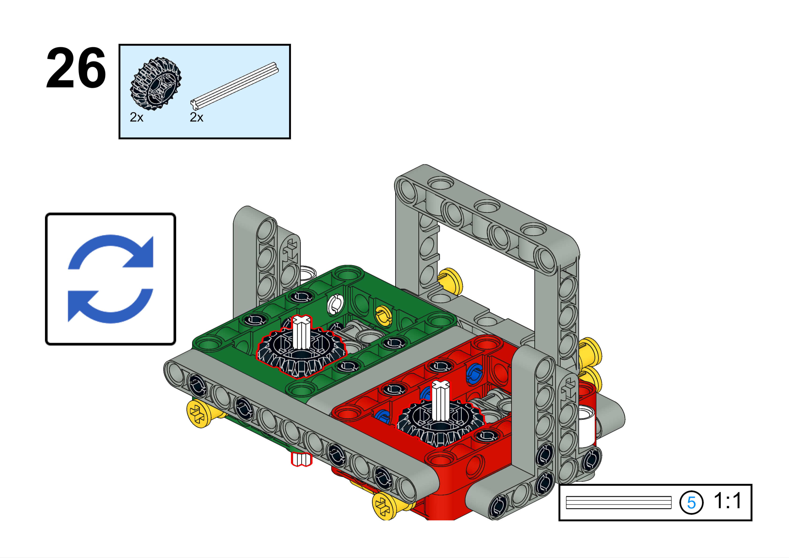

Slide 29
Step one is complete. Now you have to decide which way you want your axle(s). Don’t worry if you decide wrong—it happens all the time and it’s very easy to fix

Slide 30
Left-Right Axle Attachments
If you don’t need any left-right axles, and you only need forward axles, skip ahead about ten pages.

Slide 31
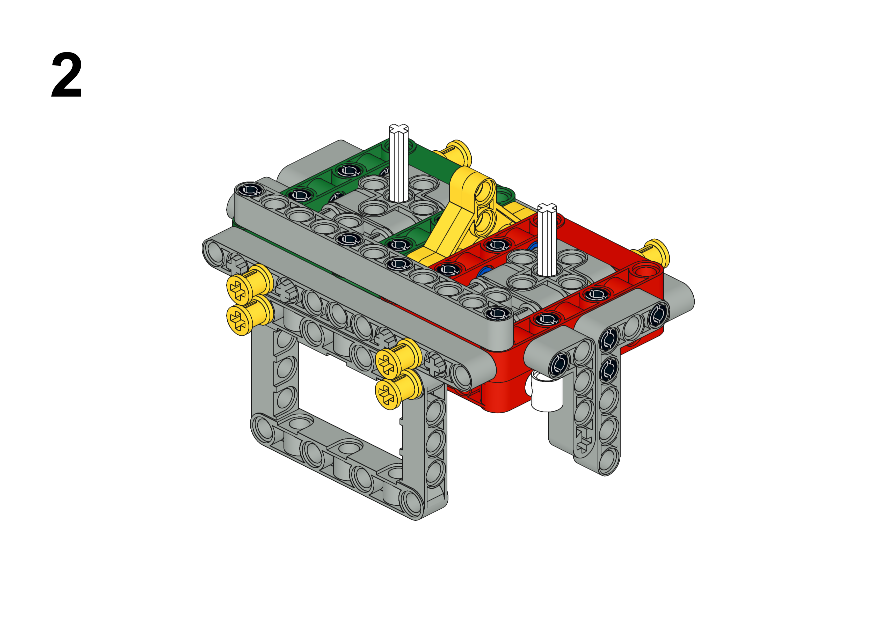
Left-Right Axle
Start with this
Forward

Slide 32
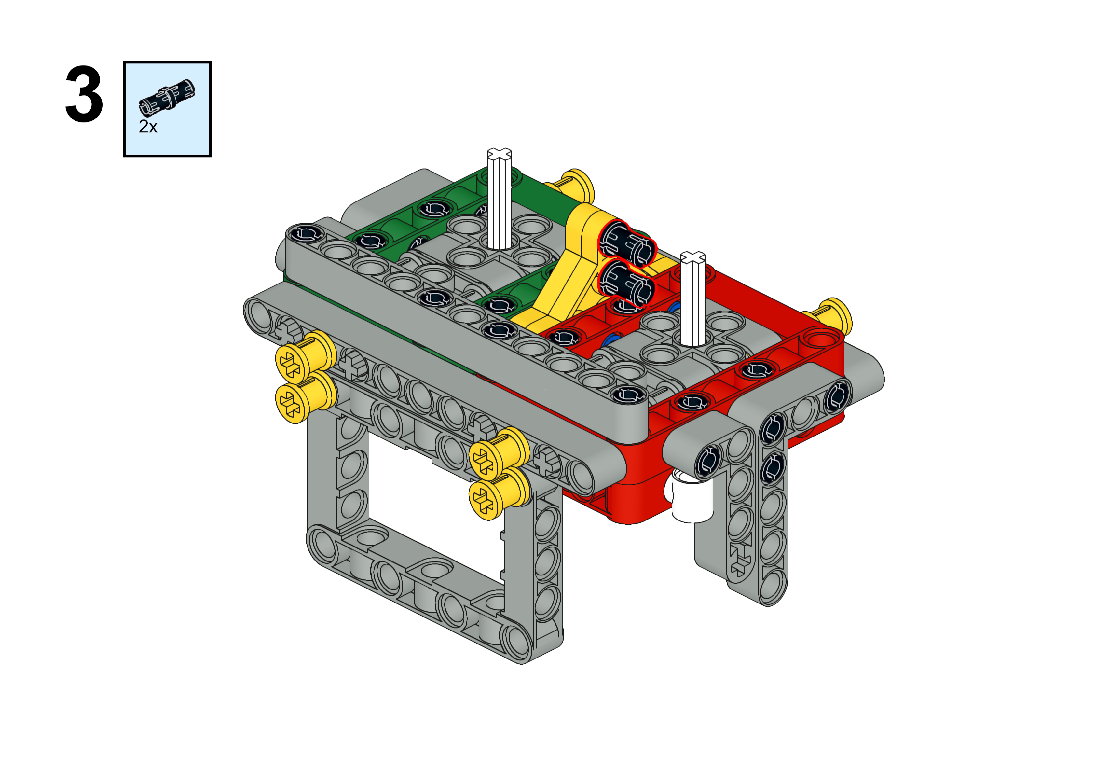
Left-Right Axle
Are you putting left-right axle attachments on each side? If so, use the long blue pegs on this step instead of the black pegs as shown here. Then just follow the steps but duplicate everything on both sides.
Forward

Slide 33
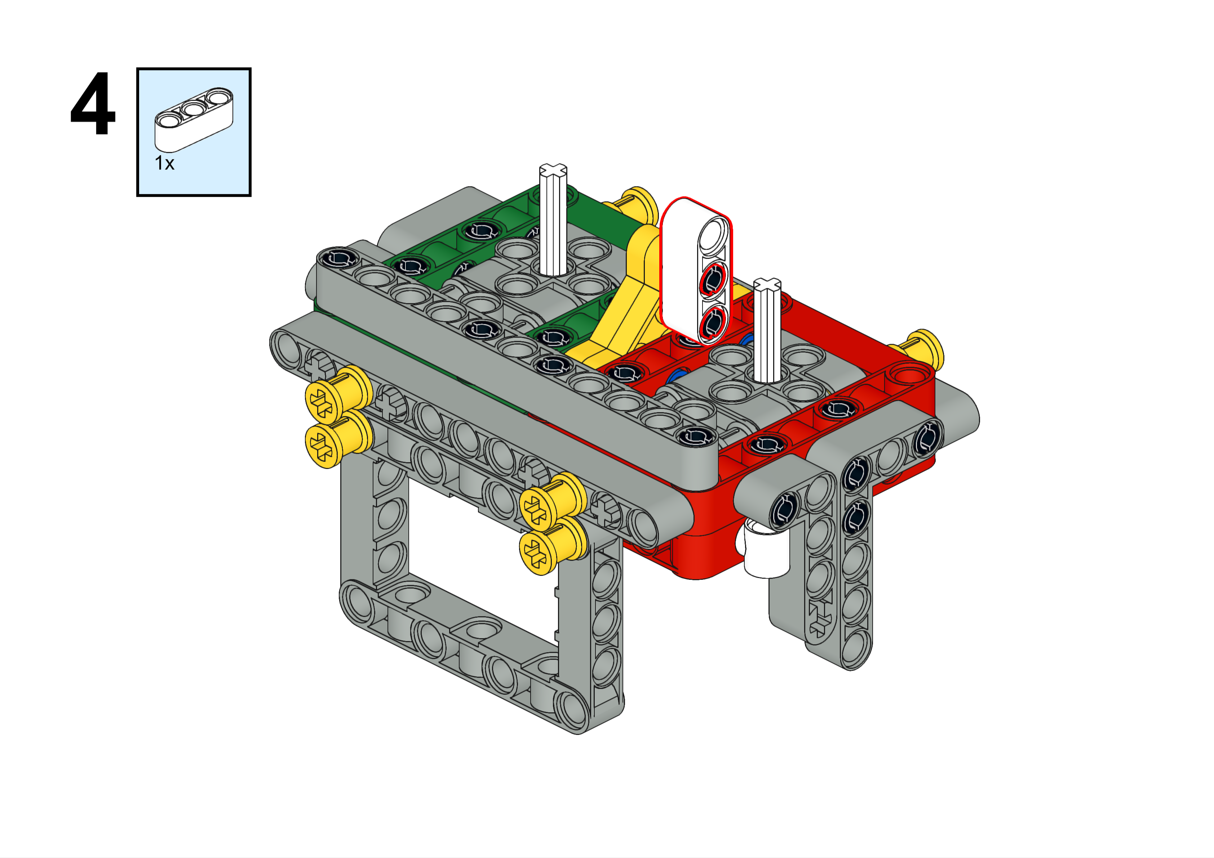
Left-Right Axle
Forward

Slide 34
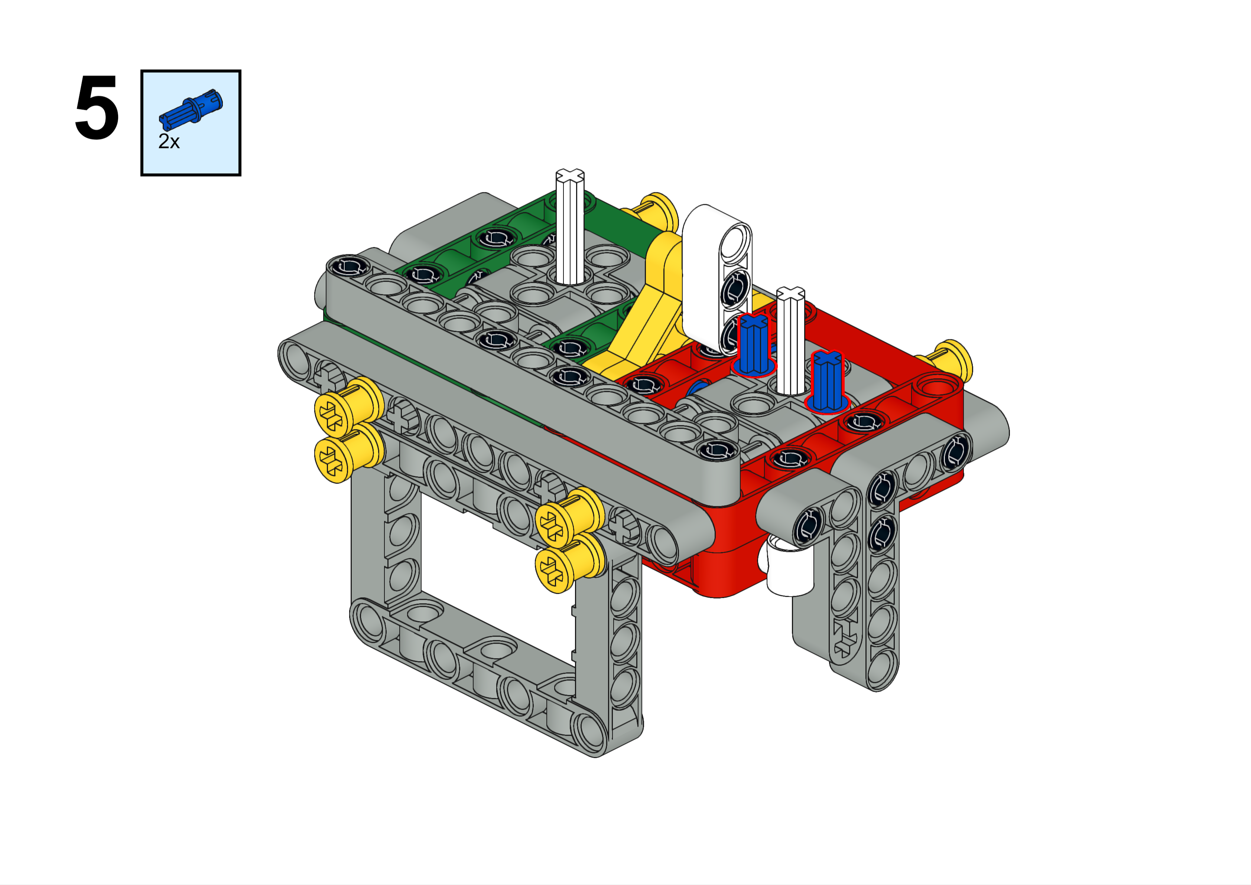
Left-Right Axle
Forward

Slide 35
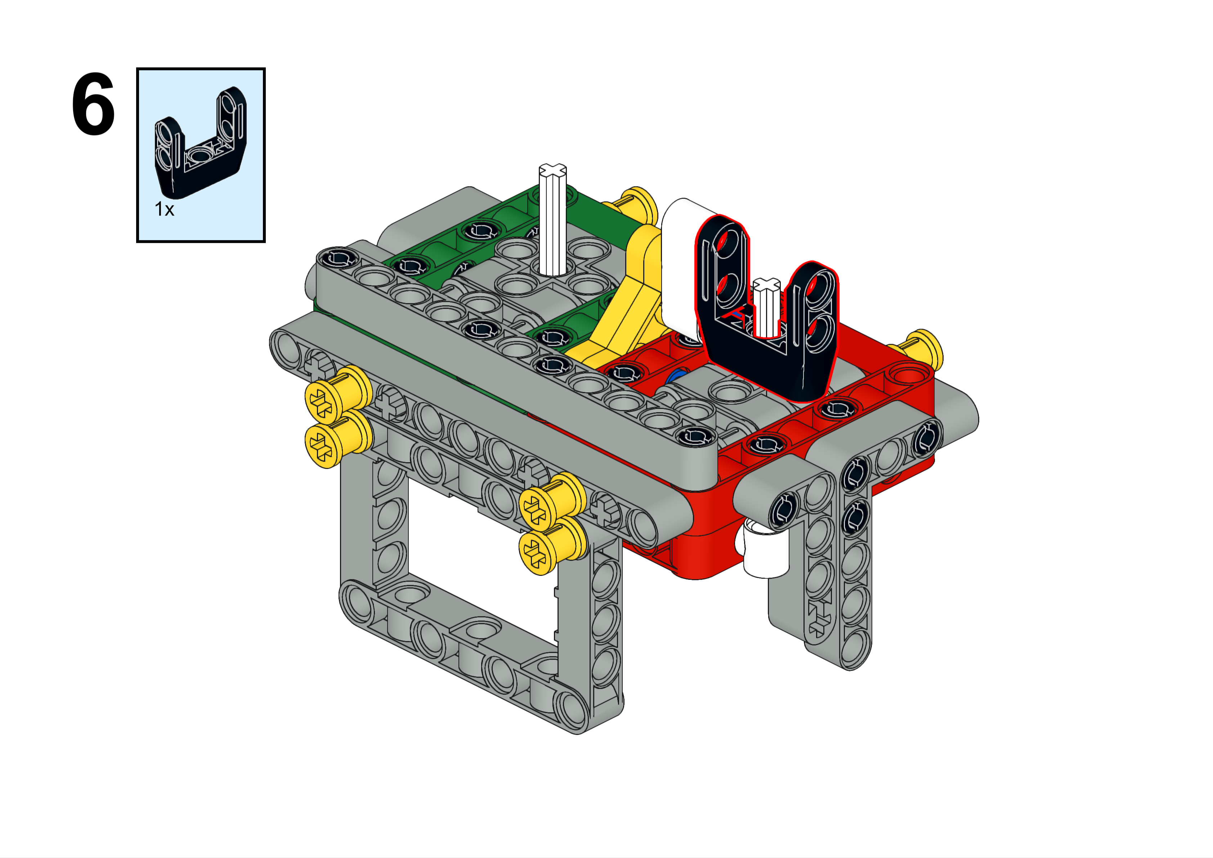
Left-Right Axle
Forward

Slide 36
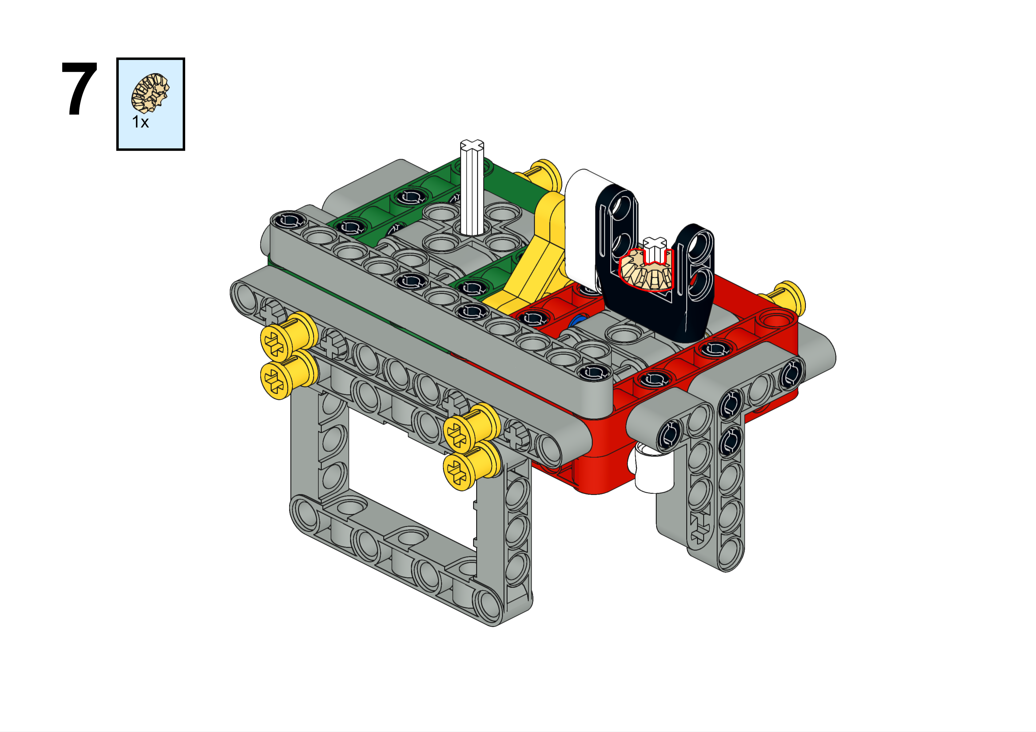
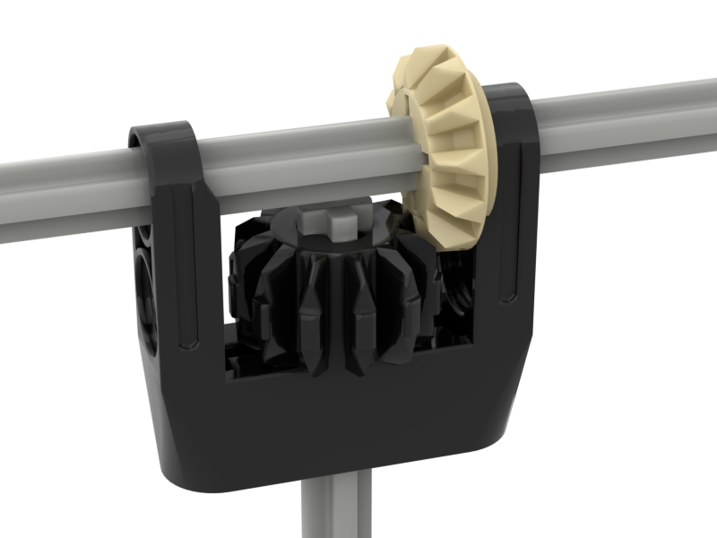
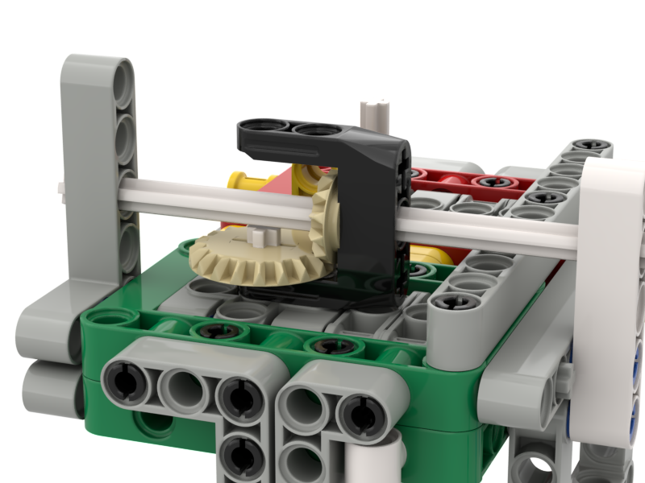
Left-Right Axle
Decision Time! You have an option here. You can go with the instructions which will have a small gear turning a big gear, or you can go with the option below, which has two gears of the same size. What difference does that make? Which will you choose?
There is even an option to have a big gear turning a small gear. Why might we want to do that?
Forward

Slide 37
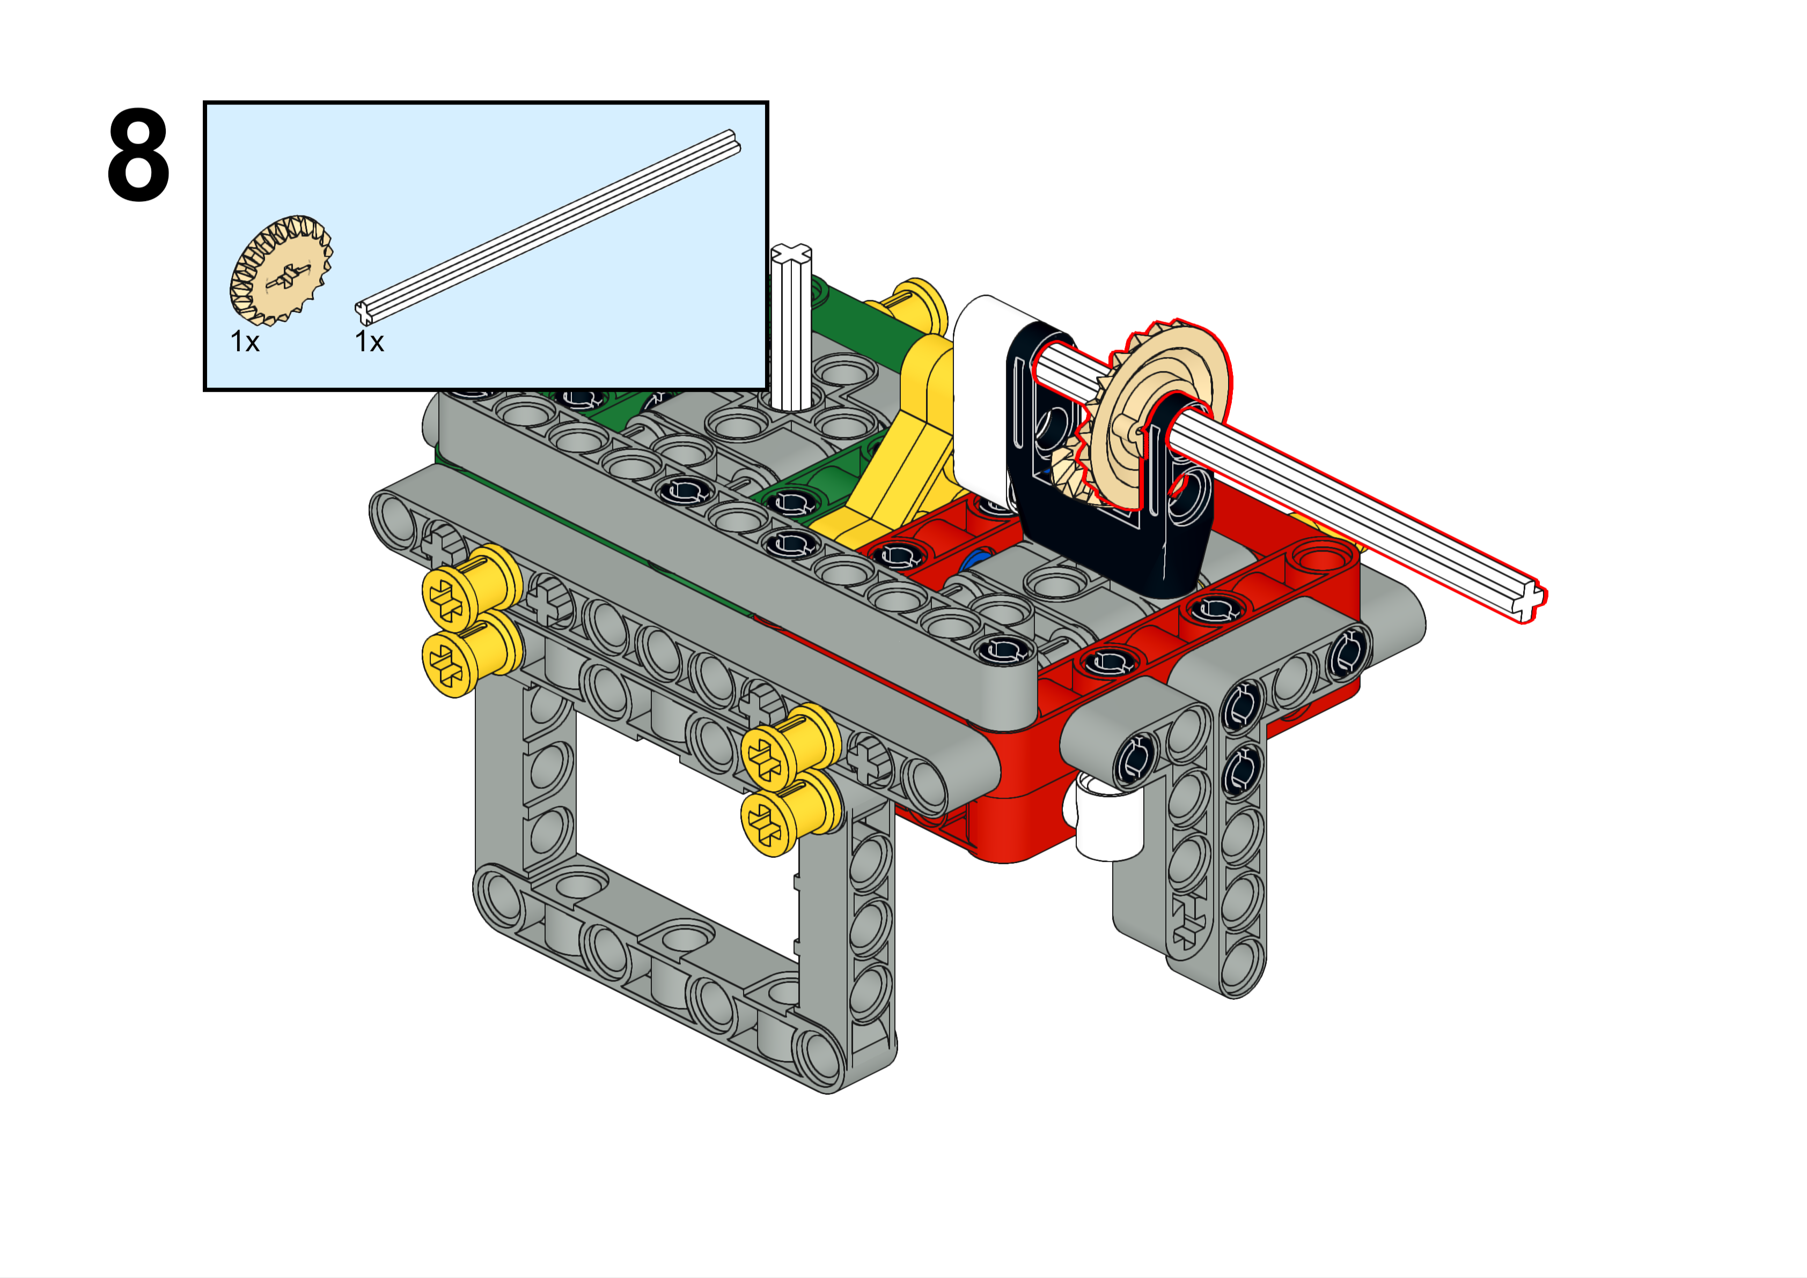
Left-Right Axle
Choose whatever axle length you need here. Each situation is different and you have to figure it out.
Forward

Slide 38
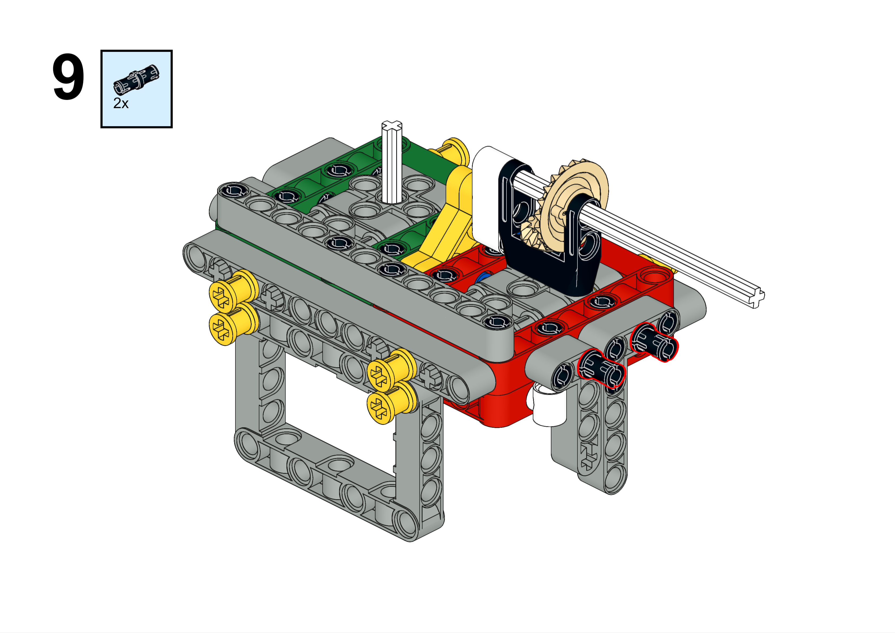
Left-Right Axle
Forward

Slide 39
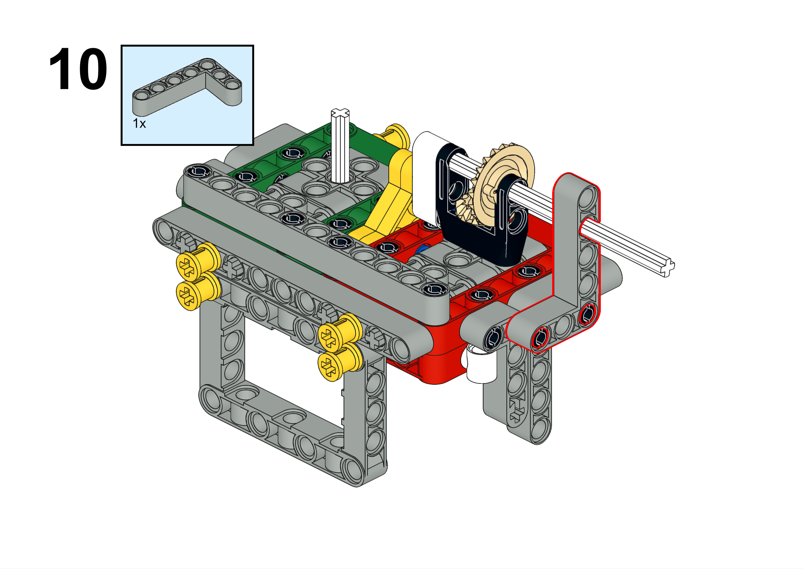
Left-Right Axle
Forward

Slide 40
Forward Axle Attachments

Slide 41
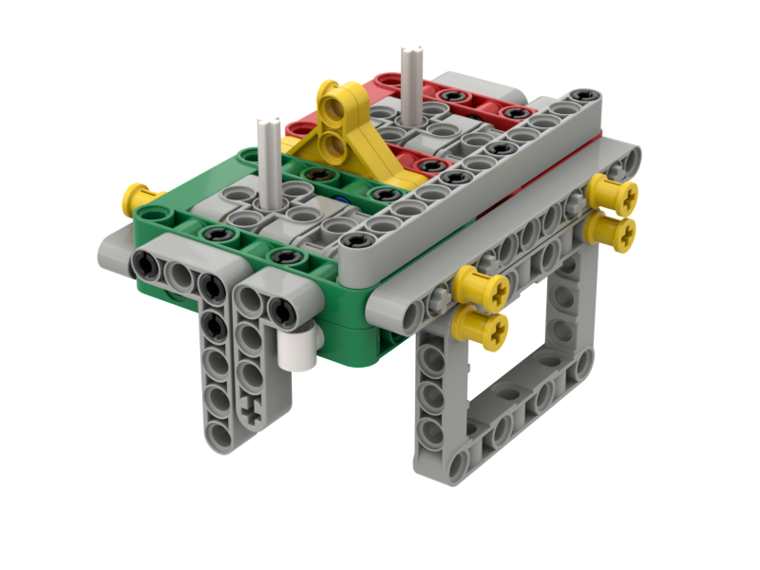
Forward Axle
First, remove these three push pins on the side where you are installing the forward-facing axle.

Slide 42
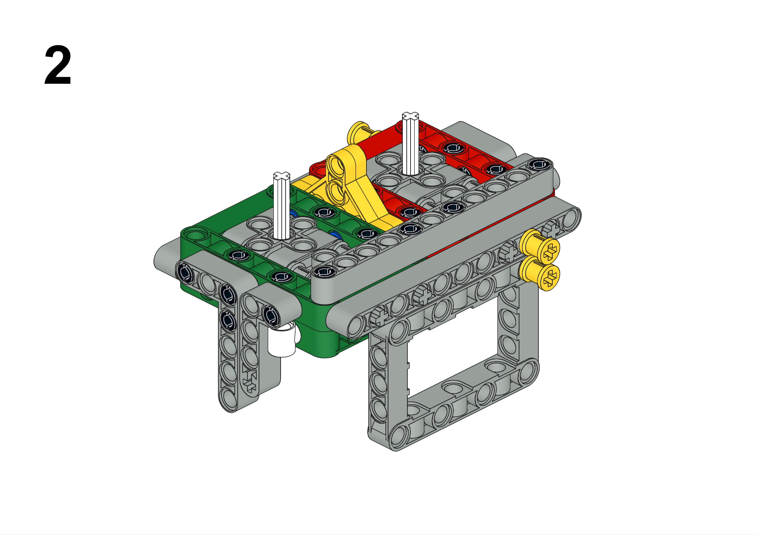
Forward Axle
Push pins are removed.
Forward

Slide 43
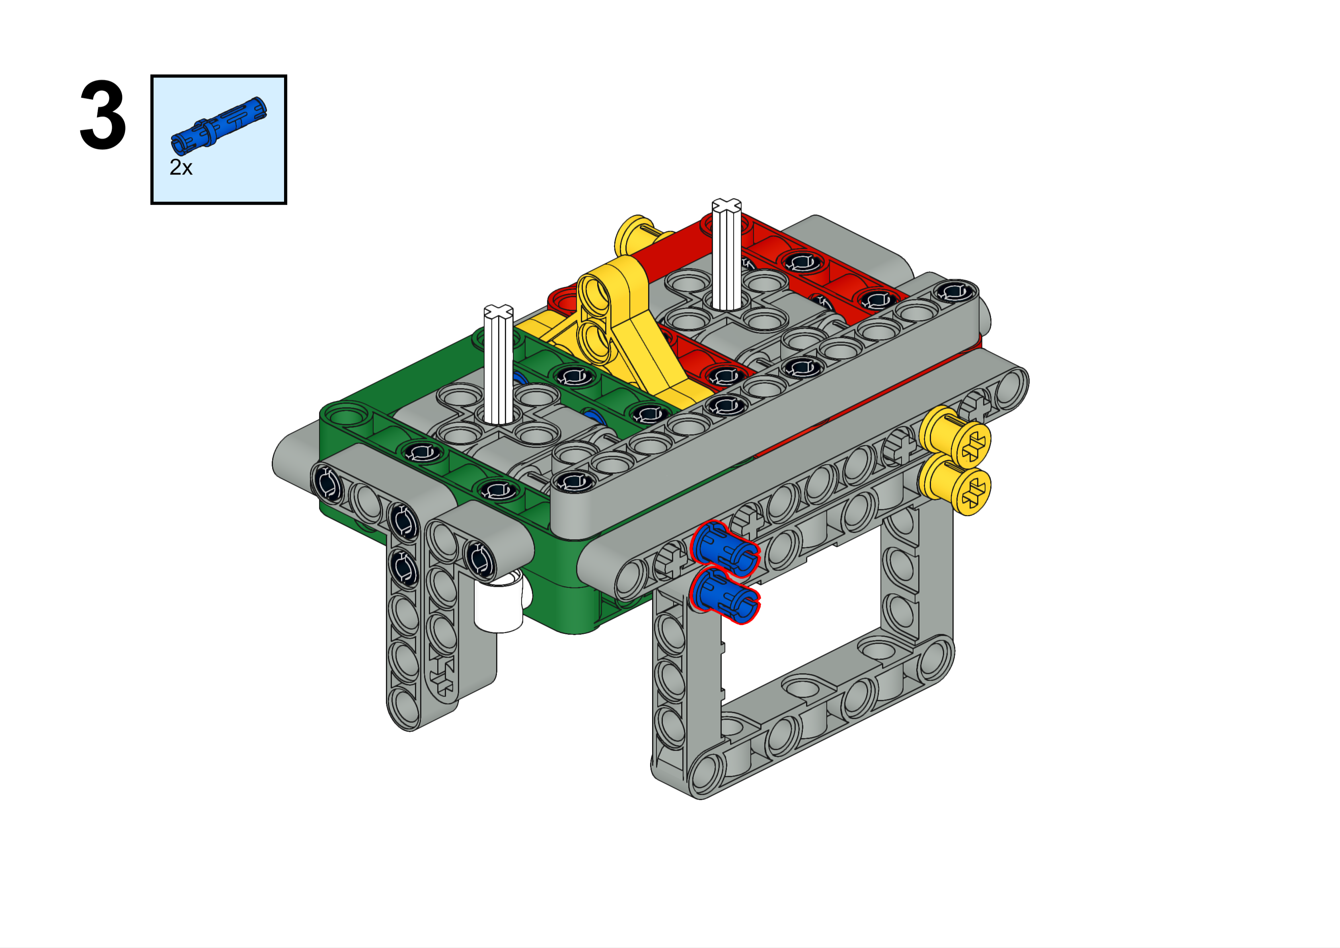
Forward Axle
Forward

Slide 44
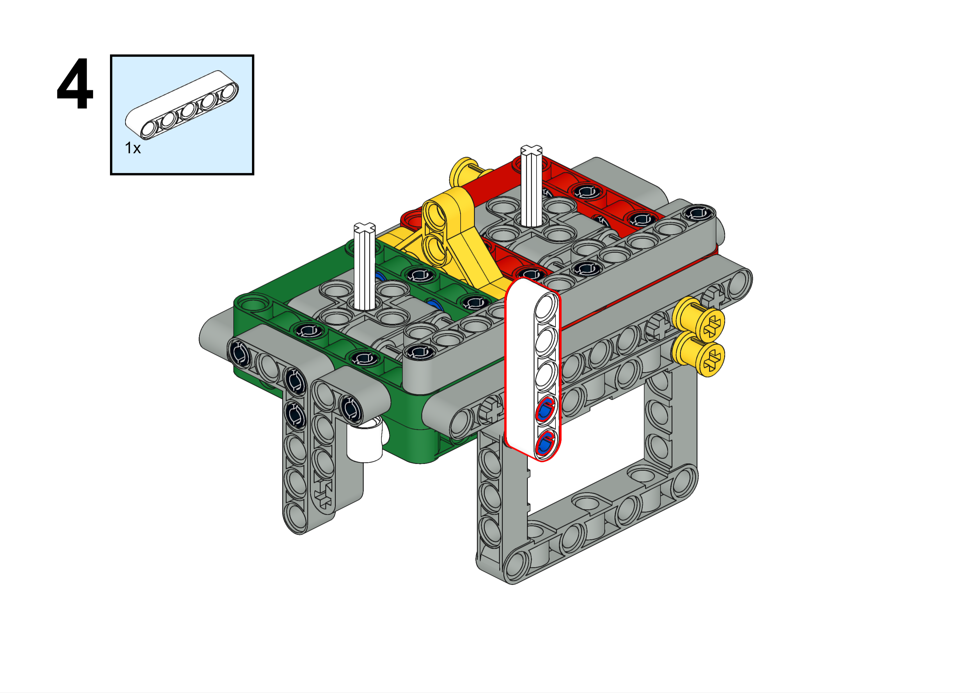
Forward Axle
Forward

Slide 45
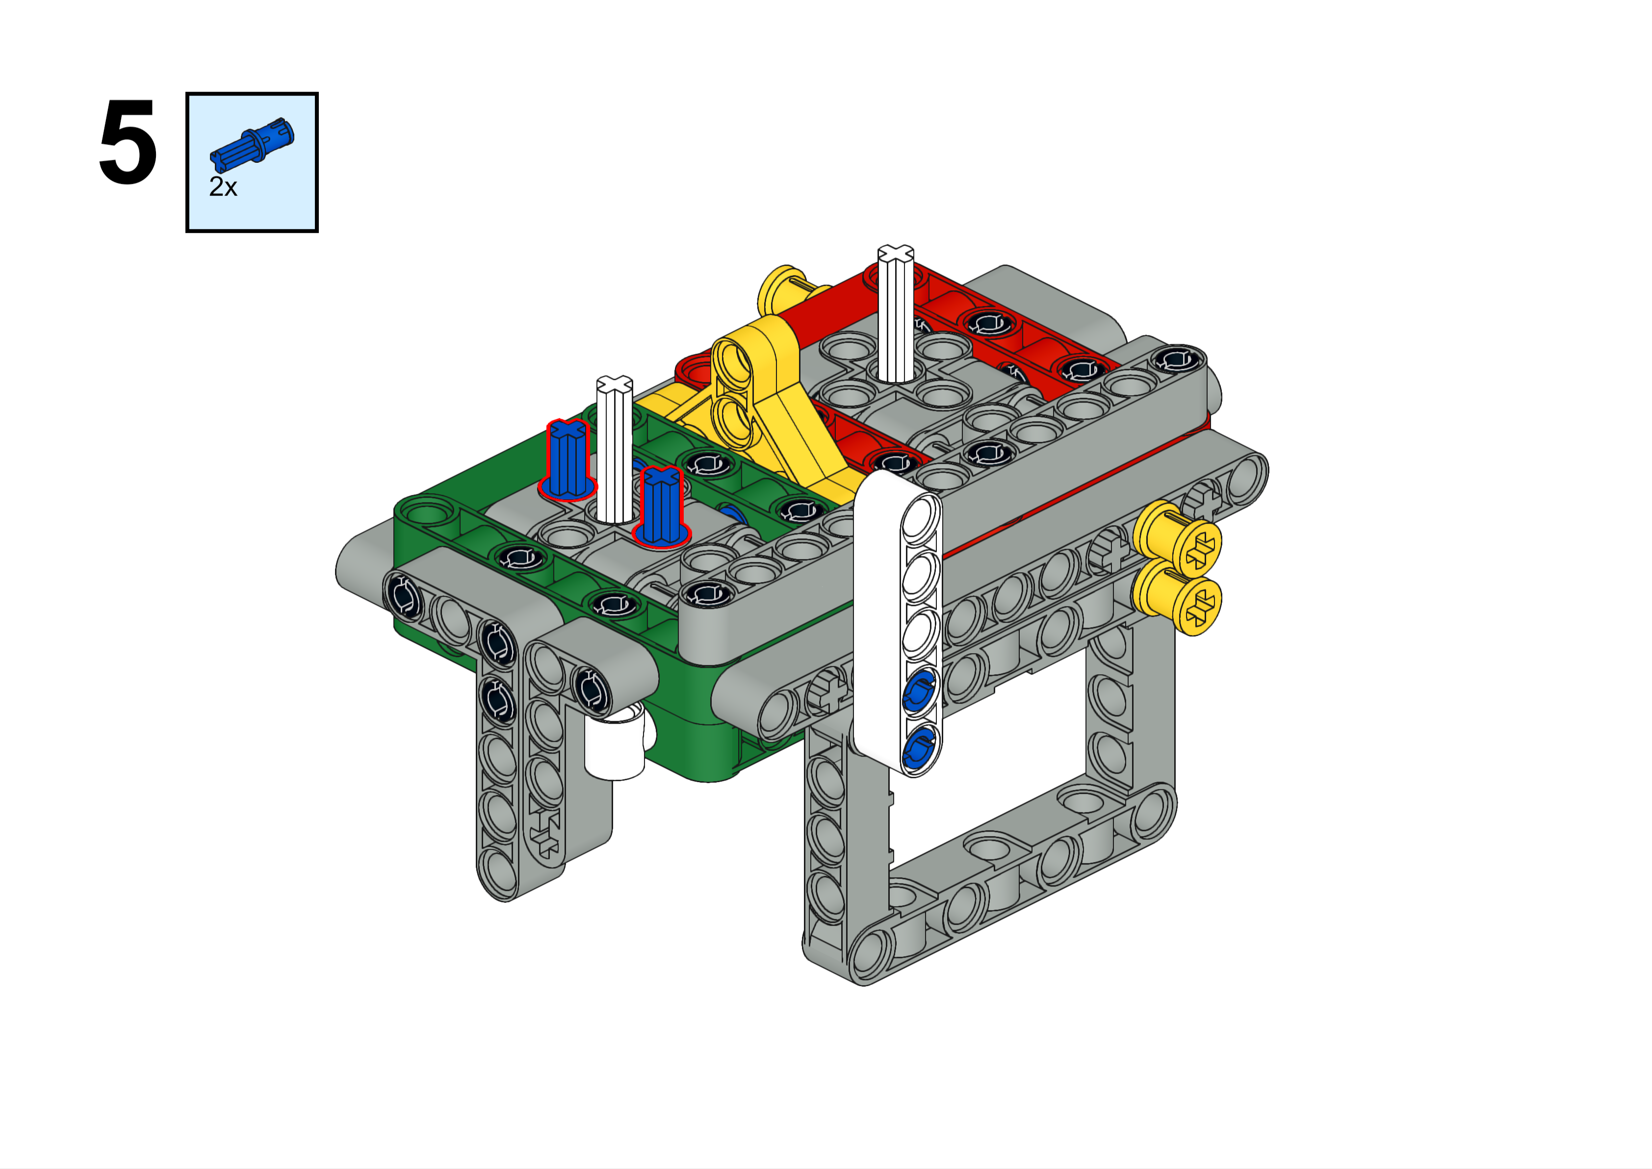
Forward Axle
Forward

Slide 46
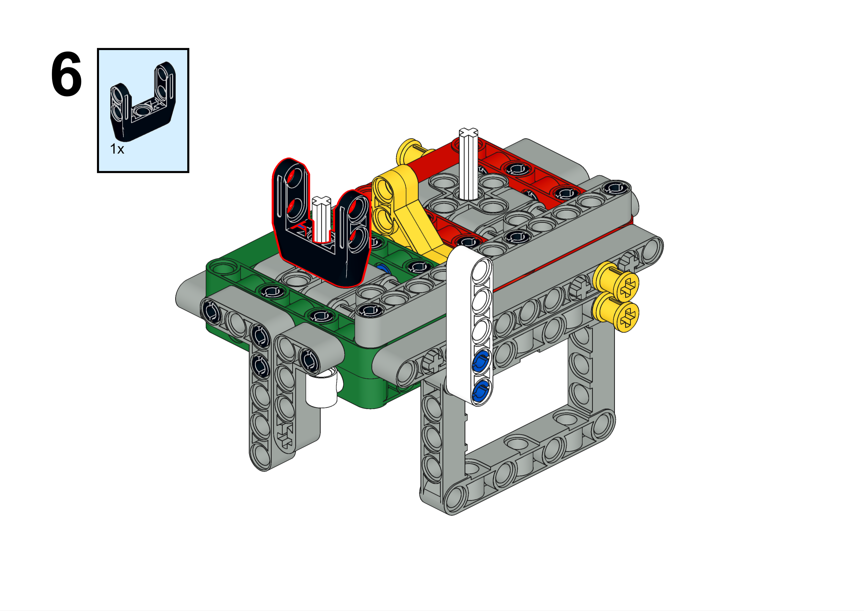
Forward Axle
Forward

Slide 47
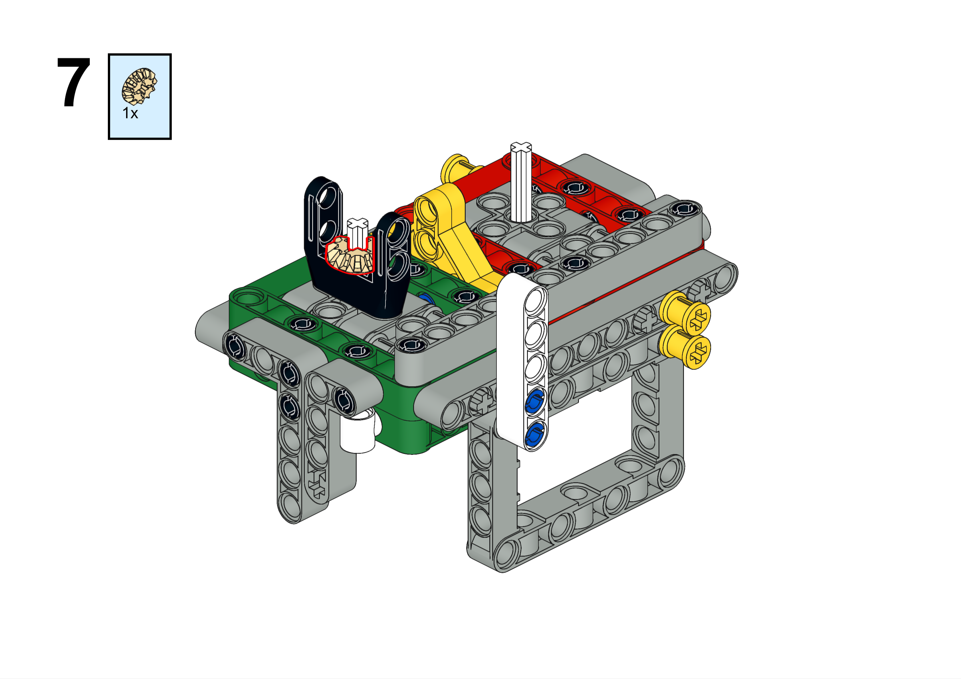
Forward Axle
Decision Time! You have an option here. You can go with the instructions which will have a small gear turning a big gear, or you can go with the option below, which has two gears of the same size. What difference does that make? Which will you choose?
There is even an option to have a big gear turning a small gear. Why might we want to do that?
Forward

Slide 48
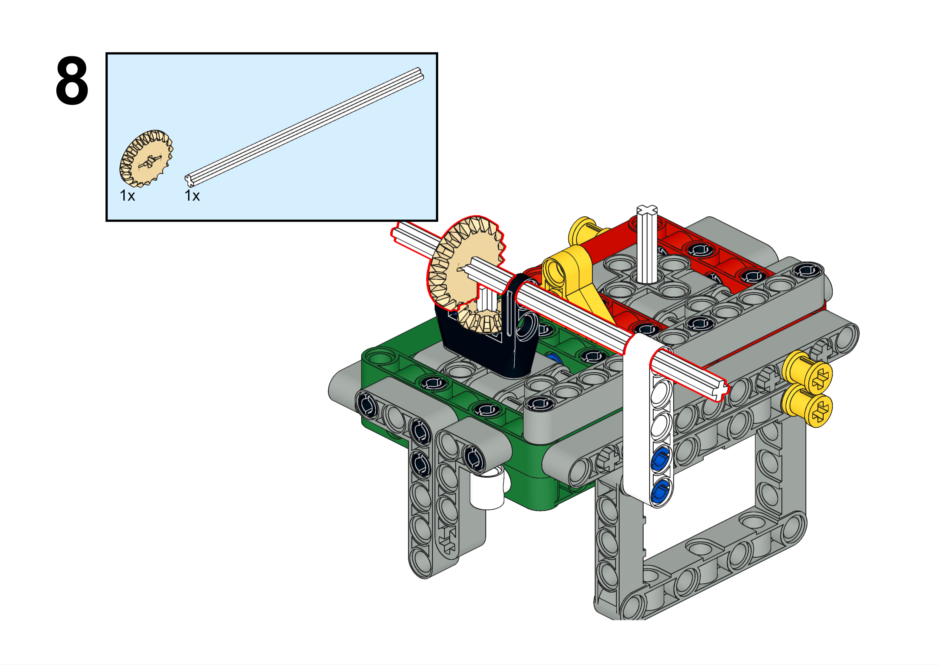
Forward Axle
Choose whatever axle length you need here. Each situation is different and you have to figure it out.
Forward

Slide 49
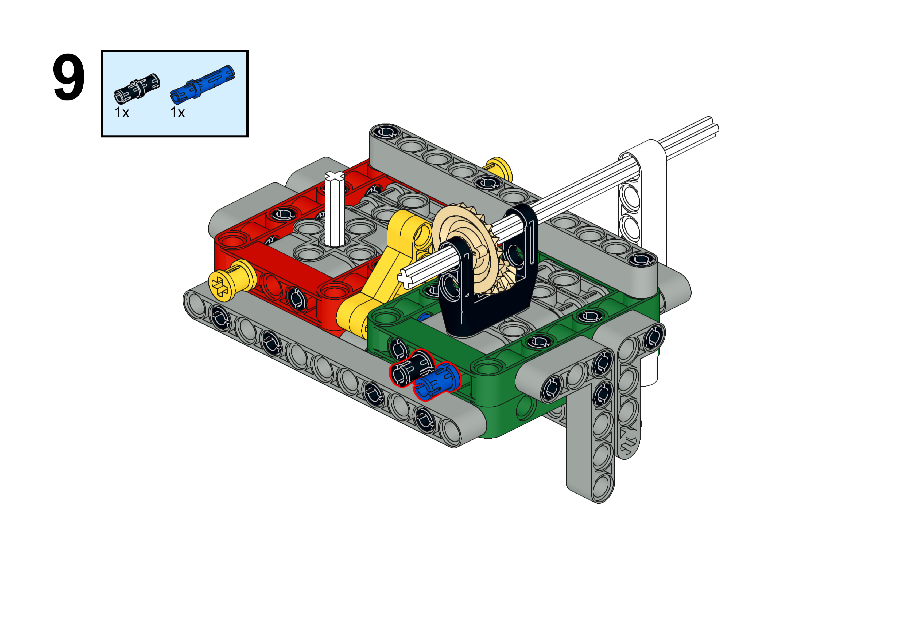
Forward Axle
Forward

Slide 50

Forward Axle
Forward

Slide 51
“Big Turning Small” Attachment
Big Turning Small

Slide 52

Big Turning Small
First, replace the 5L axle with a 4L. Here, we are working on the green side. When done, it will be a forward axle, but the idea is the same for a left-right axle.

Slide 53

Big Turning Small

Slide 54

Big Turning Small

Slide 55

Big Turning Small

Slide 56

Big Turning Small

Slide 57

Big Turning Small
Choose whatever axle length you need here. Each situation is different and you have to figure it out.

Slide 58

Big Turning Small

Slide 59

Big Turning Small

